Slide 1
Writing Web Content
Corporate Web Development Training:
Part 2
Top 5 tips for writing online

Slide 2
Top 5 tips for writing online
Part 2
Be direct – content that’s understood quickly
Be concise – edit or produce content so it’s straight to the point
Make content scannable – easy to scan read
Be conversational – friendly and welcoming
Be active – avoid using the passive voice, have helpful content

Slide 3
1. Be Direct
Top 5 Tips for Writing for the Web
Use clear/descriptive page titles and headings so they can be understood quickly. This is really important for search engines too, so your content appears in the right results.
Always have a Brief introduction that states the point of the page, use keywords that your audience is looking for.
Notes:
3

Slide 4
Headings & Page Titles
Headings and page titles are very important.
They are signposts to your content.
They are crucial to helping people find your page:
they will pull people into your site from a search
if they are already on your site, they confirm to readers they are on the right page
They can also appear in many different formats:
they are the first thing your audience will see in search results
they appear as links on home pages, or in sidebar navigation
in social media posts
Notes:
4

Slide 5
Headings & Page Titles
Front load them so the most important words are at the beginning. This helps scan reading, making it easier and quicker for people to understand your content.
Use keywords about your subject. This helps with better search engine ranking for your page, and also supports scan reading.
Try to Keep them short so they’re easier faster to read.
Be clear and descriptive so it’s easy to see the relevance of your page. This tells readers they are in the right place.
Always avoid jargon or word play. Most people are on a task to find information. They will just ignore irrelevant/incomprehensible things to get to their destination.
Notes:
5

Slide 6
Page Title Examples
Descriptive title
Gives a good idea of what you can expect if you choose to read the full article.
Vague title
This could literally be about any topic – most people won’t bother to read the summary or read more.
Notes:
6

Slide 7
Page Titles
Our Standards
50 characters (including spaces)
Heading Level 1 (H1) for page titles using title case
Menu items also use title case
Only use ampersands in side menus. Use ‘and’ in page titles and other text
Notes:
7

Slide 8
Subheadings
Always try to use Subheadings in your content.
They break up content into easier to read ‘chunks’.
People can scan read them quicker to predict what content will be on a page. They can then see if they are on the right page, and if they should invest time reading more.
They can tell a story.
Subheadings visually stand out more so are easier to scan read. This helps people pick out relevant information.
Use keywords to support scan reading
Keywords supports scan reading – the 'F' shape reading pattern
Notes:
8

Slide 9
Subheadings
Our Standards
30 characters (including spaces)
H2 to H5 for sub-headings using sentence case
Notes:
9

Slide 10
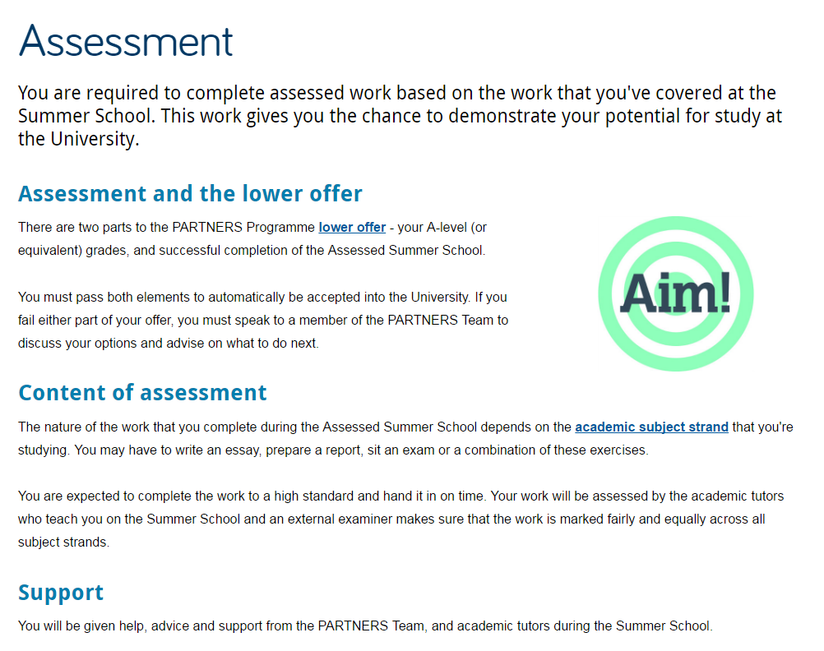
Headings & Subheadings Example
Good
Short but descriptive Page title
Uses subheadings to split up text and to introduce each section
Supports scan reading
Notes:
10

Slide 11
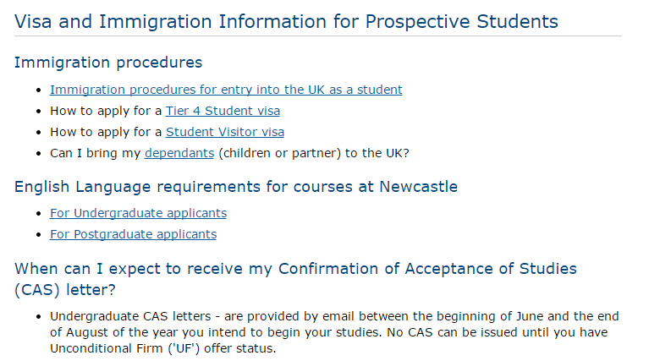
Headings & Subheadings Example
Bad
Page title too long - hard to read
Subheadings are used, but followed by bullet points – no context given for each section
Subheadings too long – hard to read
Use of question format is harder to comprehend (especially for international students) and clashes with tone on the rest of the page.
Notes:
11

Slide 12
Introductions
Every standard page should have a short introduction.
A good introduction can orientate readers. It tells them they are in the right place and they’ll get the information they want.
You have about 3 seconds to get a readers attention and 5 to keep it. If it’s not clear what a page is for, people leave.
Our introductions are Styled differently from the main body content.

Slide 13
Introductions
Our Standards
Fewer than 50 words
Summarise the main point of the page
Use keywords to support search engine optimisation

Slide 14
2. Be Concise
Top 5 Tips for Writing for the Web
Keep your content brief and your users are more likely to read it
Focus on what your visitors want to know, or do
Notes:
14

Slide 15
Page Content
Think about how to answer your audiences questions and make sure they can complete tasks (apply, book, download, contact)
Write using sub headings, short sentences and short paragraphs
Remove unnecessary words - ‘Please note’, ‘Fill in this form by…’, ‘Thank you for visiting’
Our Standards
200-300 word count (including an introduction)
20 word sentences
50 word paragraphs (around two sentences)
Notes:
15

Slide 16
Page Content
Always check your content
Accuracy – make sure links work and there are no misspellings. As a university this is particularly important.
Currency – is it up to date? If your information is out of date – how reliable can it be? Remove references to past events and old documents. Out of date content automatically makes people think you don’t take care.
Readability – read it through. Is your message clear? Could it be more direct or simple?
Follows our standards – check your content against our standards http://www.ncl.ac.uk/demo/editorial-guide/
Notes:
16

Slide 17
Page Content
Check your readability - fast
Use the free, online Hemingway Editor to check/improve your readability. The lower the score the better!
http://www.hemingwayapp.com/
Notes:
17

Slide 18
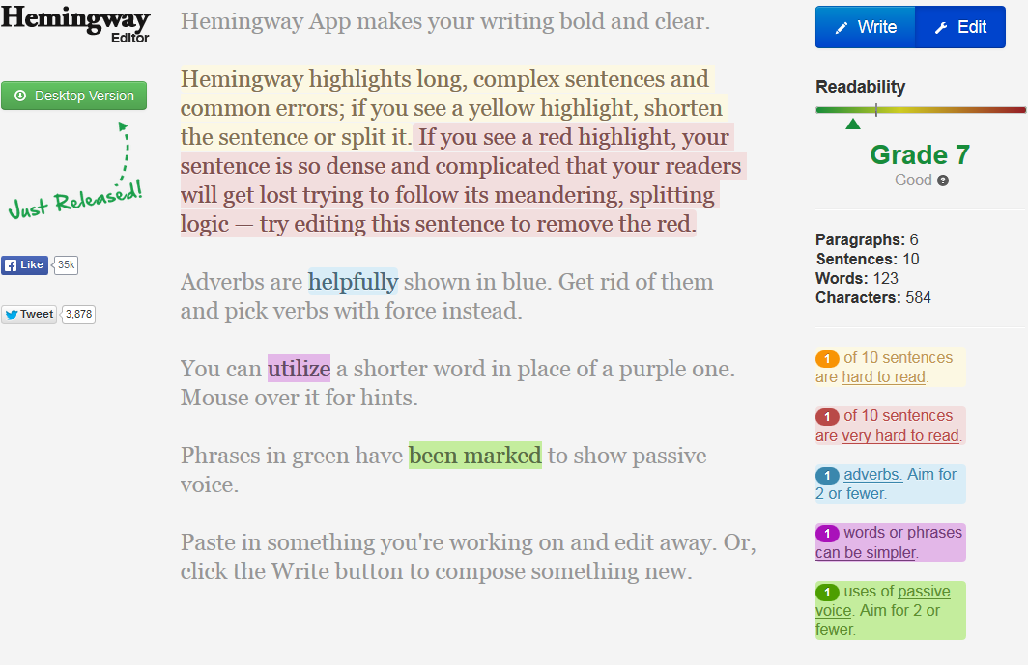
Hemingway Editor Demo
Paste/write in your content
Hemingway makes suggestions to improve your readability, and colour codes them
Make your edits online to see your score improve (The lower the better)
Copy content back into word
Notes:
18

Slide 19
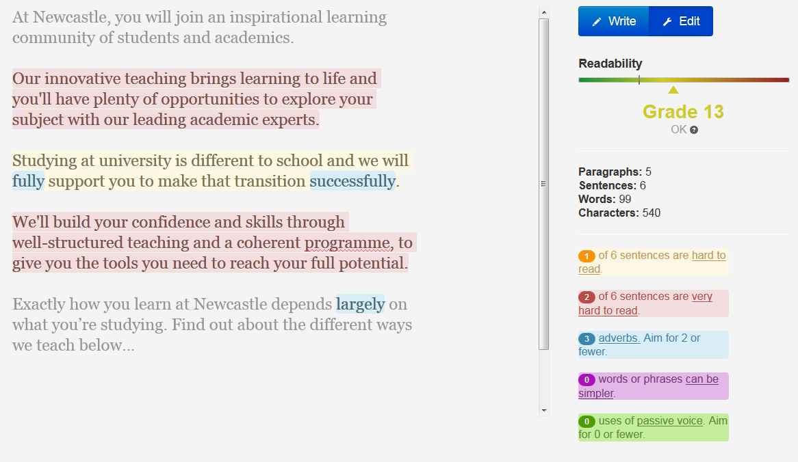
Example – Before Editing
This example is taken from the UG website
Grade 13 is ‘OK’
But can be improved with a couple of small changes

Slide 20
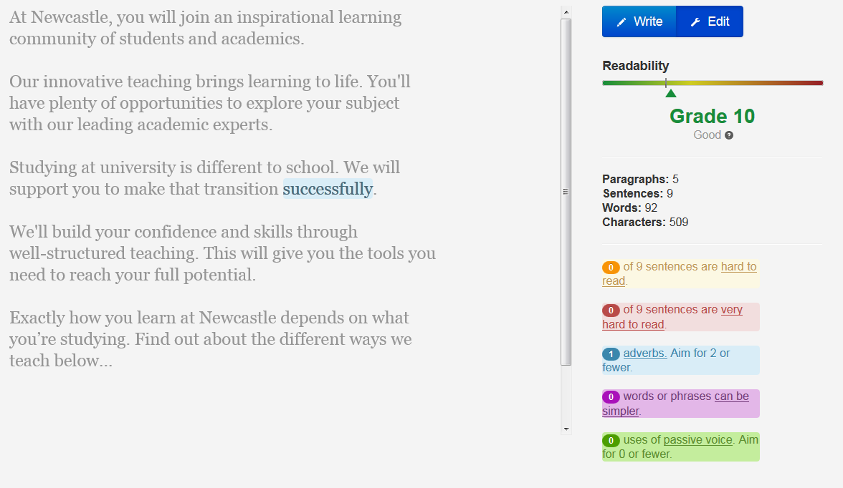
Example – After Editing
Long sentences have been split up - shorter and easier to read
Removed some adverbs not really needed
Improved readability score - Grade 10 ‘Good’
Simple but effective changes

Slide 21
3. Make Content Scannable
Top 5 Tips for Writing for the Web
Visitors to your site won’t read from start to finish
They will scan around the page looking for visual pointers
Notes:
21

Slide 22
Scannable Content
Reading online is different to print. People won’t read all of your content - they scan.
They notice the first paragraph, words and headings – known as the ‘F’-shaped pattern. They also look for visual pointers:
sub-headings
lists
bold
keywords
Task-focused – if you don’t answer people’s questions, they go elswhere.
You have about 3 seconds to get a readers attention and 5 to keep it. If it’s not clear what a page is for, people leave.
Notes:
22

Slide 23
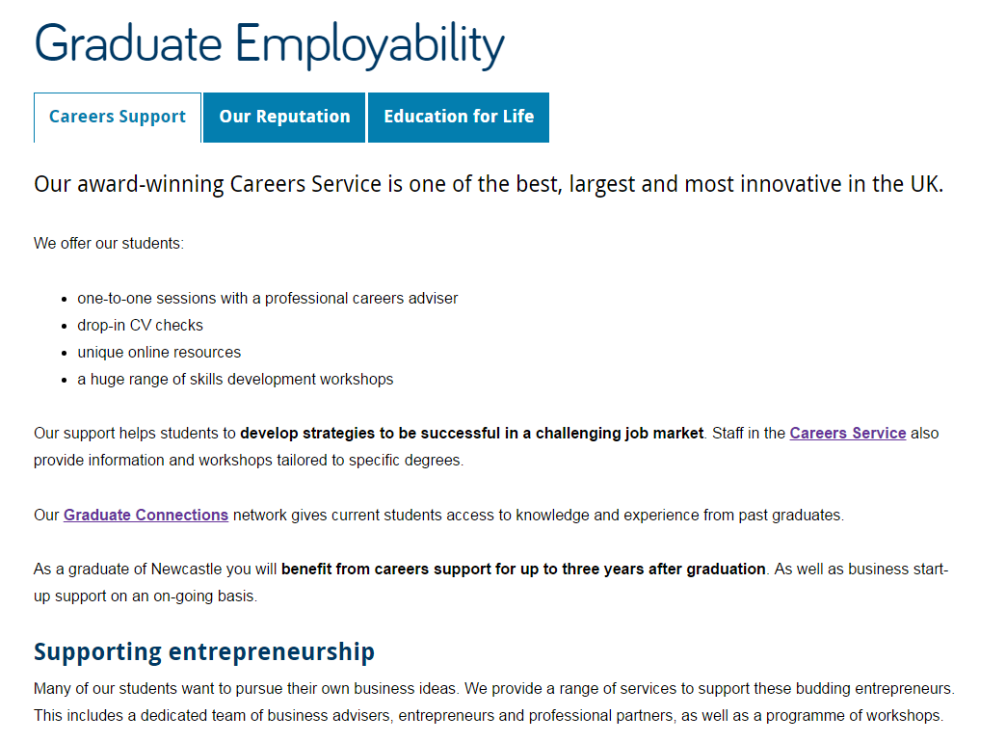
Scannable Example 1
Good
Short and descriptive page title
Concise introduction
List is effective in highlighting what’s on offer, breaks up text and adds white space
Hyperlinks are relevant and helpful
Bold phrases highlight key information
Short sub-heading is descriptive and introduces content that follows
Notes:
23

Slide 24
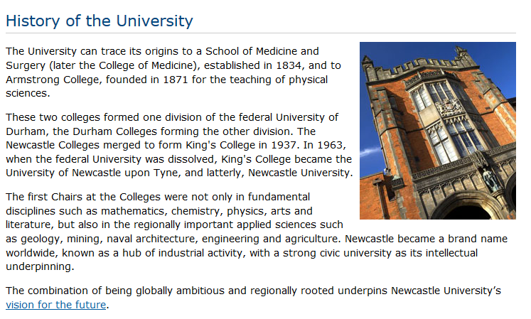
Scannable Example 2
Bad
Longer blocks of text – hard to scan read
No subheadings to break up text, or introduce content blocks
No bold to emphasise key phrases
No lists to add white space or emphasis key points
Notes:
24
No subheadings to break up text
No bold to emphasise key words
No lists to add white space

Slide 25
Lists
Lists are used to break up your content. They are:
easier to read – use fewer words and introduce white space
fragments or phrases, not full sentences
Use:
a minimum of three bullets and up to six
bullets points rather than numbers – only use numbered lists to guide a user through steps or a 'top 5'
bold to emphasise, start with key words
Notes:
25

Slide 26
Standards for Lists
Bulleted lists:
follow on from a colon
start each point in lower case and don’t end with punctuation
begin with keywords
keep each point short – aim for around 10 words
Numbered lists
Don’t follow on from a colon.
Start each step with a capital and end with a full stop.
Notes:
26

Slide 27
Lists Example 1
Bad
Our volunteers are currently involved in a range of activities, including:
Being the welcoming face of our venues.
Volunteering in the stores and helping to catalogue our extensive collections.
Volunteering with the learning teams to explain exhibits to visitors.
Bringing our rail heritage alive by helping with the day to day running of the museum.
Stewarding or assisting with the organisation of special events.
Grey shading shows scan reading focus
Uses capital letters at start of each point
Full sentences, with punctuation – harder/slower to read
Repetition of words at the beginning of each point
Notes:
27

Slide 28
Lists Example 2
Good
Our volunteers are involved in a range of activities:
welcoming visitors and providing information
cataloguing our extensive collections
explaining exhibits to visitors and facilitating exhibitions
day to day running of the museum to bring our rail heritage to life
stewarding or assisting with the organisation of special events
Grey shading shows scan reading focus
Bold on some words for emphasis, help scanning
Points start with keywords and uses different, action words for each point
Notes:
28

Slide 29
Bold
Use of bold helps with scannability and emphasis:
bold text creates a quickly scannable ‘at a glance’ impression of the page, telling users what to expect from the content
works for humans and computers - highlighting key phrases in bold helps to improve search engine optimisation (SEO)
Notes:
29

Slide 30
Bold
You should bold text that:
communicates important information
emphasises key points
makes sense out of context
complements titles and headings
An easy way to check if you’ve used bold effectively is to collect your bold phrases into one list. If you gave this list to someone, would they understand what the page is about?
Always add bold after you’ve finished creating your content.
Notes:
30

Slide 31
Bold
Bold is the only formatting you should use to add emphasis. Don’t:
make entire sentences or paragraphs bold
make too many individual words bold
use italics for emphasis – hard to read online
use underline text for emphasis – ONLY used for hyperlinks
use CAPITAL LETTERS for emphasis – too shouty!
Notes:
31

Slide 32
4. Be Conversational
Top 5 Tips for Writing for the Web
Use a friendly and welcoming tone of voice
Imagine you’re talking to the reader and write as you’d speak
Notes:
32

Slide 33
Tone of Voice
Write in a conversational tone, be friendly and welcoming:
address the audience as 'you‘ – ‘You can find out more about’
use contractions eg we’ll, you’re
use simple short words and clear language:
'before’ not 'in advance of‘
'send' not 'transmit‘
Always remove jargon to reduce formality, and increase understanding
cut caveats like ‘please note’
See the Plain English Guide (PDF: 174KB) for other ways to simplify your language
Notes:
33

Slide 34
5. Be Active
Top 5 Tips for Writing for the Web
Notes:
34

Slide 35
Active Voice
Using an active voice rather than passive voice:
helps with your conversational style
encourages your users to engage with your content
helps your users complete their tasks
‘you write great web content’
not ‘great web content is written by the team’

Slide 36
Active Voice Examples
Use active voice in your content, then it’s naturally direct:
Active voice: Someone has cleaned the windows Passive voice: The windows have been cleaned
Active voice: The girl was washing the dog
Passive voice: The dog was being washed by the girl
Active voice: Beautiful giraffes roam the savannah
Passive voice: The savannah is roamed by beautiful giraffes.

Slide 37
Helpful content
Your aim is to help a user find an answer or complete a task, not to keep them on your website:
if you want them to complete a task, help them with your words and hyperlinks
link to relevant content elsewhere - don't duplicate content on your site if it's somewhere more appropriate
do you need to introduce something to them: a video, related content, contact details?
Notes:
37

Slide 38
Hyperlinks
Hyperlinks help you to write actively, support scan-reading and enhance search engine optimisation. They:
help highlight keywords because they underline
give active instructions – should prompt you to do something
offer a next step: place links at the end of your content
are always descriptive – do not use ‘click here’ or ‘download’
must work – check that they go to the destination page
But don’t group too many together – it’s harder for mobile readers to hit the link targets on smaller screens.
Notes:
38

Slide 39
Hyperlink Standards
Writing Web Content
Corporate Web Development Training:
Hyperlinks
are descriptive and meaningful
link phrases of 3-4 words not entire sentences or paragraphs
always open destination content in same window – users can choose to open a new tab
Part 2 Complete
Be direct
Be concise
Make content scannable
Be conversational
Be active
Notes:
39

