Slide 1
Writing Web Content
Corporate Web Development Training:
Part 2
Top 5 tips for writing online

Slide 2
Top 5 tips for writing online
Part 2
Be direct
Be concise
Make content scannable
Be conversational
Be active

Slide 3
1. Be Direct
Top 5 Tips for Writing for the Web
Use clear/descriptive page titles and headings – understood quickly, and also helps search engines rankings
Brief introductions - state the point of the page, use keywords
Notes:
3

Slide 4
Headings & Page Titles
They should:
begin with keywords to support scan reading
be kept short so they are easier to read, match menu items if possible
be clear and descriptive so it’s easy to see relevance
avoid jargon or word play
Your page title is crucial to helping people find it, and can appear in many different ways/forms:
Search results
Links on home pages, sidebars
Social media
Notes:
4

Slide 5
Page Title Examples
Descriptive title
Gives a good idea of what you can expect if you click through to read the full article.
Vague title
This could be about any topic – many people won’t bother to read the summary or click through to read more.
Notes:
5

Slide 6
Page Titles
Standards
50 characters (including spaces)
H1 for page titles using title case
Menu items also use title case
Only use ampersands in side menus. Use ‘and’ in page titles and other text
Notes:
6

Slide 7
Headings
Use Sub Headings in your content – they are easier to scan read and help people pick out relevant information
Use keywords to support scan reading
They support reading online - remember the 'F' shape reading pattern
Standards
30 characters (including spaces)
H2 to H5 for sub-headings using sentence case
Notes:
7

Slide 8
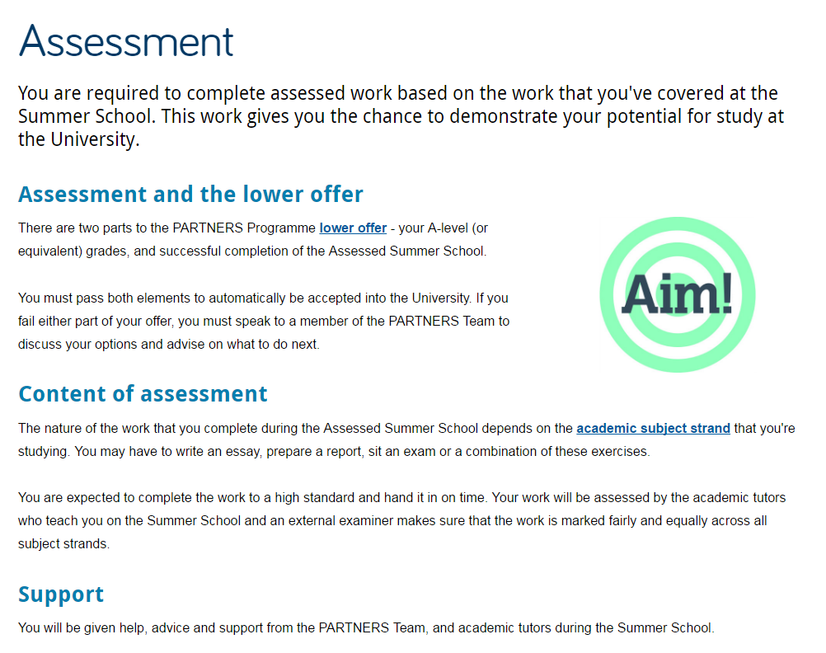
Headings Example
Good
Short but descriptive Page title
Uses sub headings to split up text and to introduce each section
Supports scan reading
Notes:
8

Slide 9
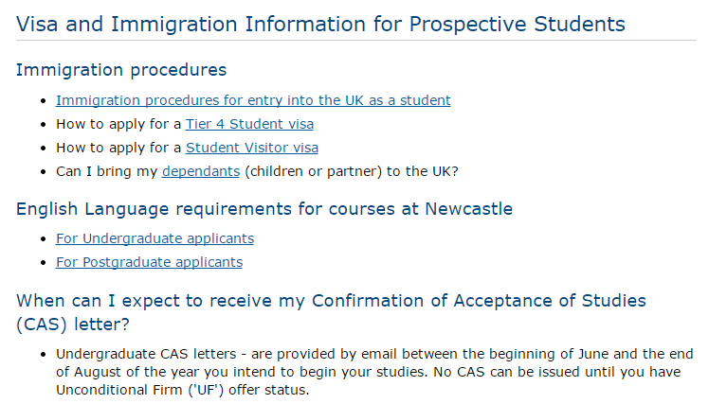
Headings Example
Bad
Page title too long - hard to read
Sub headings are used, but followed by bullet points – no context given for each section
Sub headings too long – hard to read
Use of question format is harder to comprehend (especially for international students) and is at odds with rest of copy on page
Notes:
9

Slide 10
Introductions
Each page should have an introduction
Introductions state the point of the page
If it’s not clear what a page is for, users leave
Styled differently from the main body content
Standards
Fewer than 50 words
Summarise the main point of the page
Use keywords to support search engine optimisation

Slide 11
2. Be Concise
Top 5 Tips for Writing for the Web
Keep your content brief and your users are more likely to read it
Focus on what your visitors want to know, or do
Notes:
11

Slide 12
Page Content
Think about how to answer your audiences questions and make sure they can complete tasks (apply, book, download, contact)
Write using sub headings, short sentences and short paragraphs
Remove unnecessary words - ‘Please note’, ‘Fill in this form by…’, ‘Thank you for visiting’
Standards
200-300 word count (including an introduction)
20 word sentences
50 word paragraphs (around two sentences)
Notes:
12

Slide 13
Page Content
Check your content
accuracy – make sure links work and there are no misspellings
currency – is it up to date? Remove references to past events and old documents
readability – read it through - is your message clear?
Use the free, online Hemingway Editor to check/improve your readability. The lower the score the better! http://www.hemingwayapp.com/
Make sure your content follows our standards
internal.ncl.ac.uk/web/style-guides/
Notes:
13

Slide 14
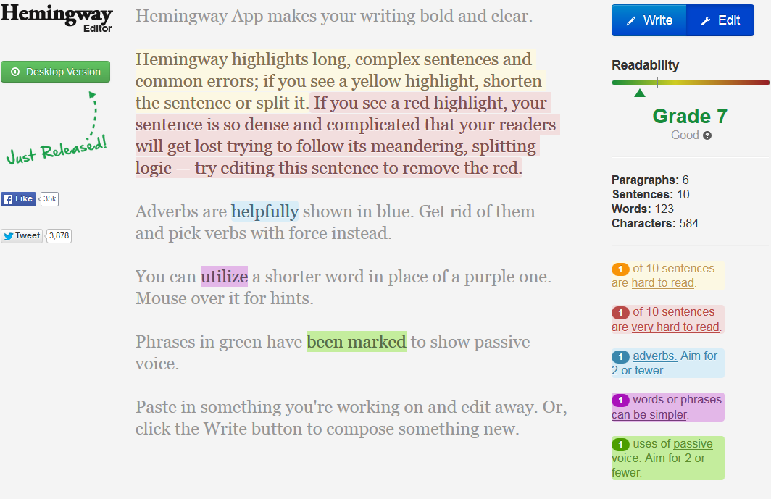
Hemingway Editor
Free to use online
Hemingway can help you edit
Paste in your content
Hemingway will highlight specific words to show issues
Edit to improve
Note the readability score
Copy content when done
Notes:
14

Slide 15
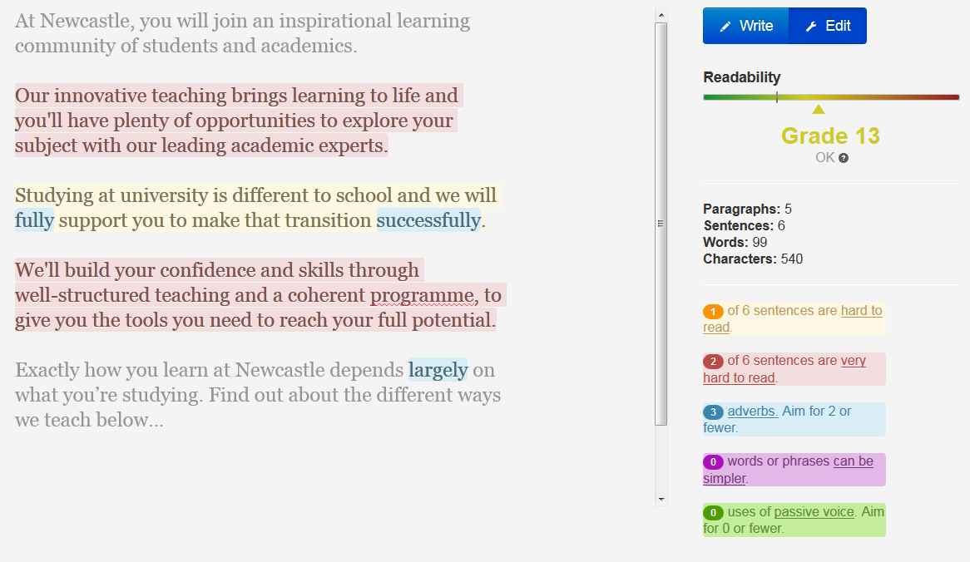
Example – Before Editing

Slide 16
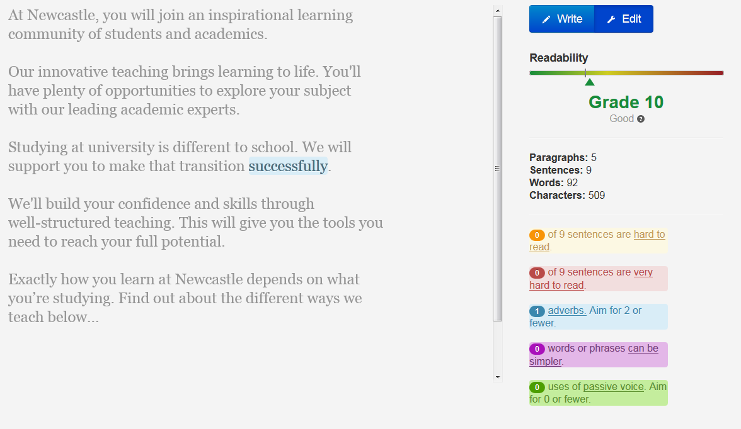
Example – After Editing

Slide 17
3. Make Content Scannable
Top 5 Tips for Writing for the Web
Visitors to your site won’t read from start to finish
They will scan around the page looking for visual pointers
Notes:
17

Slide 18
Scannable Content
Reading online is different to print. People won’t read all of your content they scan
They notice the first paragraph, words and headings – known as the ‘F’-shaped pattern. They also look for visual pointers:
sub-headings
lists
bold
keywords
Task-focused – if you don’t answer people’s questions, they leave
Notes:
18

Slide 19
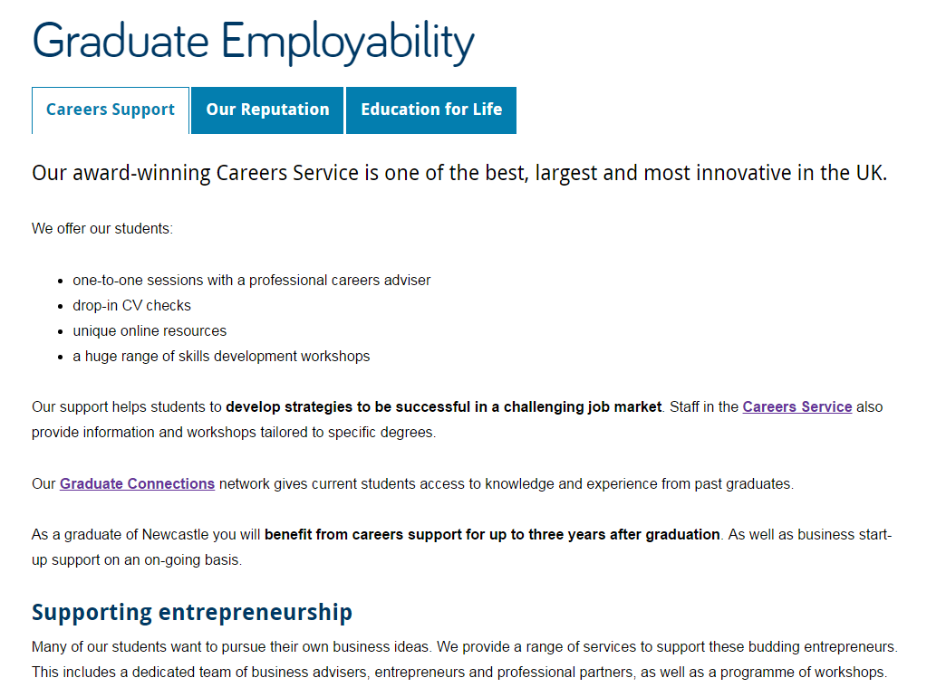
Scannable Example 1
Good
Short and descriptive page title
Concise introduction
List is effective in highlighting what’s on offer, breaks up text and adds white space
Hyperlinks are relevant and helpful
Bold phrases to highlight key information
Short sub-heading is descriptive and introduces content that follows
Notes:
19

Slide 20
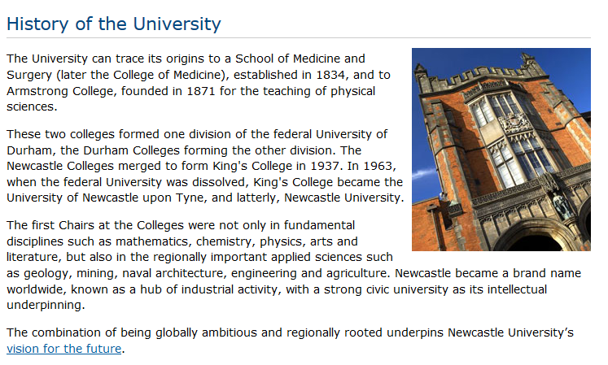
Scannable Example 2
Bad
Longer blocks of text – hard to scan read
No subheadings to break up text, or introduce content blocks
No bold to emphasise key phrases
No lists to add white space or emphasis key points
Notes:
20
No subheadings to break up text
No bold to emphasise key words
No lists to add white space

Slide 21
Lists
Use lists to break up your content. They are:
easier to read – use fewer words and introduce white space
fragments or phrases, not full sentences
Use a minimum of three bullets and up to six.
Use bullets points rather than numbers – only use numbered lists to guide a user through steps or a 'top 5'.
Use bold to emphasise, start with key words
Notes:
21

Slide 22
Standards for Lists
Bulleted lists
Follow on from a colon
Start each point with in lower case and don’t end with punctuation
Begin with keywords
Keep each point short – aim for around 10 words
Numbered lists
Don’t follow on from a colon
Start each step with a capital and end with a full stop
Notes:
22

Slide 23
Lists Example 1
Bad
Our volunteers are currently involved in a range of activities, including:
Being the welcoming face of our venues.
Volunteering in the stores and helping to catalogue our extensive collections.
Volunteering with the learning teams to explain exhibits to visitors.
Bringing our rail heritage alive by helping with the day to day running of the museum.
Stewarding or assisting with the organisation of special events.
Grey shading shows scan reading focus
Uses capital letters at start of each point – not needed
Full sentences, with punctuation – harder/slower to read
Repetition of words at the beginning of each point – all sounds too similar
Notes:
23

Slide 24
Lists Example 2
Good
Our volunteers are involved in a range of activities:
welcoming visitors and providing information
cataloguing our extensive collections
explaining exhibits to visitors and facilitating exhibitions
day to day running of the museum to bring our rail heritage to life
stewarding or assisting with the organisation of special events
Grey shading shows scan reading focus
Bold on some words for emphasis - helps scan reading
Points start with keywords and uses different, action words for each point
Follows our standards
Notes:
24

Slide 25
Bold
Use of bold helps with scannability and emphasis:
bold text creates a quickly scannable ‘at a glance’ impression of the page, which tells users what to expect from the content
works for humans and computers - Highlighting key phrases in bold helps to improve search engine optimisation (SEO)
Notes:
25

Slide 26
Bold
You should bold text that:
communicates important information
emphasises key points
makes sense out of context
complements titles and headings
An easy way to check if you’ve used bold effectively is to collect your bold phrases into one list. If you gave this list to someone, would they get the right impression about your page?
Always add bold after you have created your content for a page
Notes:
26

Slide 27
Bold
Bold is the only formatting you should use to add emphasis. Don’t:
make entire sentences or paragraphs bold
make too many individual words bold
use italics for emphasis – hard to read online
use underline text for emphasis – ONLY used for hyperlinks
use CAPITAL LETTERS for emphasis – too shouty!
Notes:
27

Slide 28
4. Be Conversational
Top 5 Tips for Writing for the Web
Use a friendly and welcoming tone of voice
Imagine you’re talking to the reader and write as you’d speak
Notes:
28

Slide 29
Tone of Voice
Write in a conversational tone, be friendly and welcoming:
address the audience as 'you‘ – ‘You can find out more about’
use contractions eg we’ll, you’re
use simple short words and clear language:
'before’ not 'in advance of‘
'send' not 'transmit‘
remove jargon to reduce formality, and increase understanding
cut caveats like ‘please note’
See the Plain English Guide (PDF: 174KB) for other ways to simplify your language
Notes:
29

Slide 30
5. Be Active
Top 5 Tips for Writing for the Web
Notes:
30

Slide 31
Active Voice
Using an active voice rather than passive voice:
helps with your conversational style
encourages your users to engage with your content
helps your users complete their tasks
‘you write great web content’
not ‘great web content is written by the team’

Slide 32
Helpful content
Your aim is to help a user find an answer or complete a task, not to keep them on your website:
if you want them to complete a task, help them with your words and hyperlinks
link to relevant content elsewhere - don't duplicate content on your site if it's somewhere more appropriate
do you need to introduce something to them: a video, related content, contact details?
Notes:
32

Slide 33
Hyperlinks
Hyperlinks help you to write actively, support scan-reading and enhance search engine optimisation. They:
highlight keywords by underlining
give active instructions – should prompt you to do something
offer a next step: place them at the end of your content
are always descriptive – do not use ‘click here’ or ‘download’
……must work – so check!
But, don’t use too many together – it’s harder for mobile readers to hit the link target.
Notes:
33

Slide 34
Hyperlink Standards
Writing Web Content
Part 2 Complete
Top 5 Tips for writing online
Be direct
Be concise
Make content scannable
Be conversational
Be active
Hyperlinks
are descriptive and meaningful
link phrases of 3-4 words not entire sentences or paragraphs
always open destination content in same window – users have the choice to open a new tab
Notes:
34

