Slide 1
Session 1
From resistance to reframing – how we understand and respond to change

Slide 2
Learning Outcomes
Session 1 From resistance to reframing – how we understand and respond to change
Key theories in response to change from a human centred perspective.
Develop reflective insight into your personal response to complexity, a key leadership attribute in MBA-level development. ​
Explore the mindset shift from passive reaction to active adaptation, mirroring the reflective and analytical capacities nurtured on the #nclMBA.

Slide 3
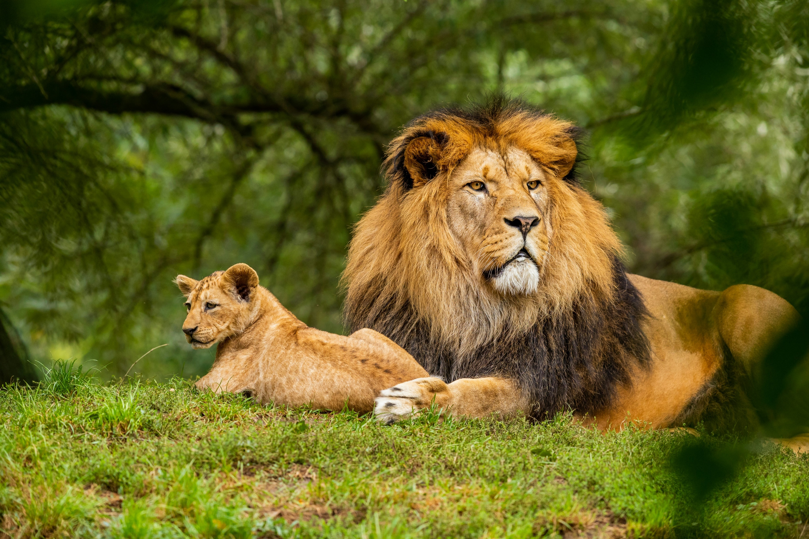
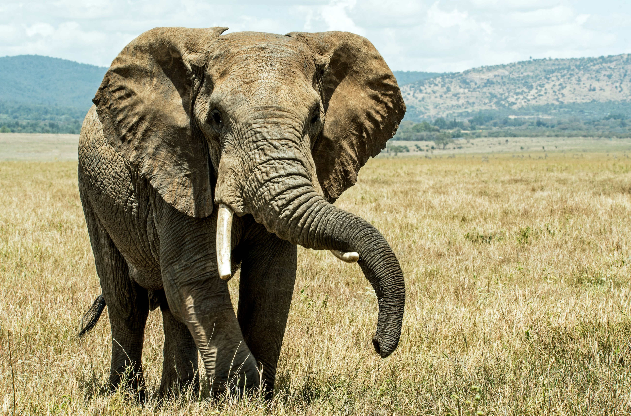

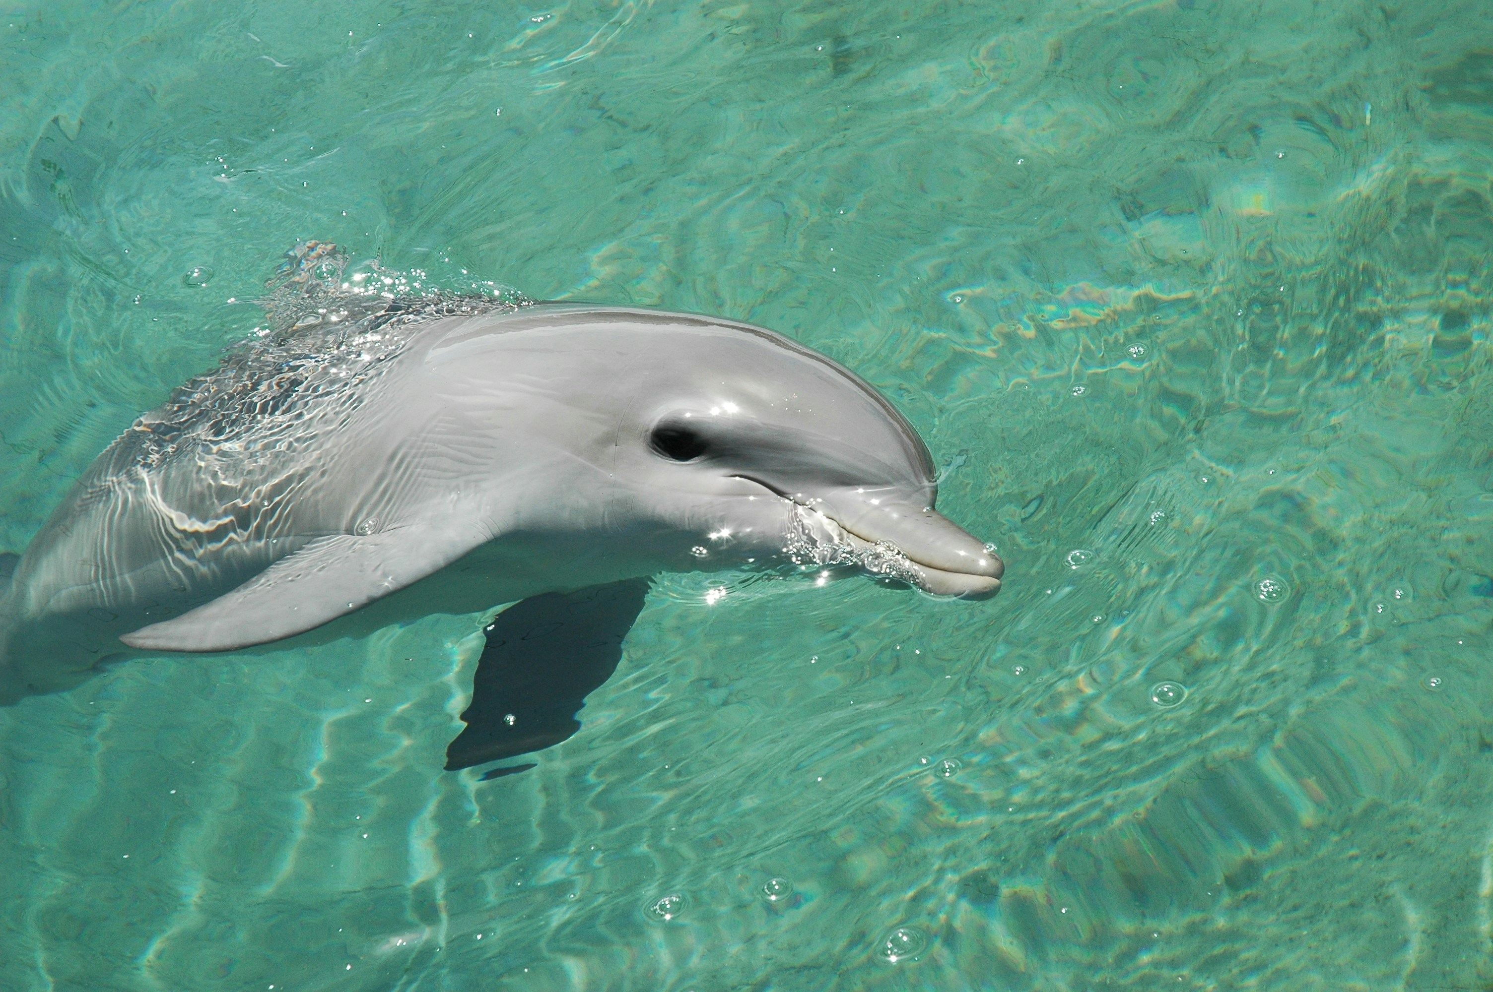

Icebreaker | How do you respond to change?
Session 1 From resistance to reframing – how we understand and respond to change
Lion:
Confident and bold, taking charge to inspire others. You champion change and like to rally people around a vision.​
Elephant:
Wise and observant, watching and ​waiting before deciding to act. You are naturally risk averse and need to be sure before you make your move.
Border Collie Dog:
Eager and action orientated, keen to jump into action and keep things moving. Proactive and energetic, you like to charge ahead.
Dolphin:
Adaptable and sociable, navigate shifting waters with ease. Open-minded and agile, you find change exhilarating and enjoyable.
Hedgehog:
Sensitive and perceptive, you are keenly attuned to risks. You can act as a barometer to others that might be inclined to recklessness.

Slide 4

Individual Task
Session 1 From resistance to reframing – how we understand and respond to change
Develop your own personal learning outcomes for this short course on “Navigating Change”​
Post them on the Padlet Board

Slide 5

Pilot in the Plane Principle – Taking control of the future
Session 1 From resistance to reframing – how we understand and respond to change
The desire for personal control is universal and deeply human, rooted in our history and present in all cultures.​
Striving for control is healthy and normal, supporting self-esteem, reducing stress, and helping prevent feelings of helplessness.​
Having control over aspects of your life such as decisions, time, and goals contributes to a sense of autonomy and freedom.​
People experience and express control differently, and the intensity of that need can shift over time and with life circumstances.​
Wanting control doesn’t make you a “control freak”, it’s often a sign of self-direction and a desire to live with purpose.

Slide 6
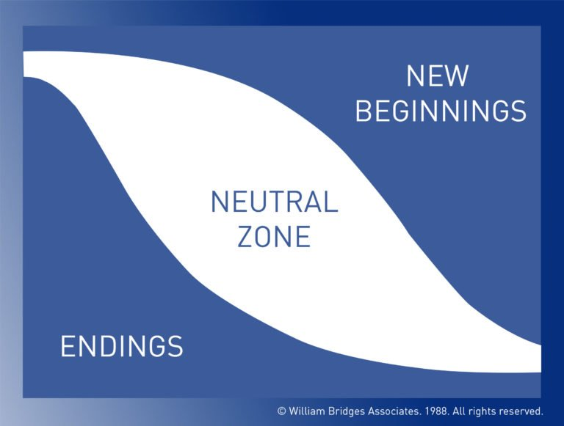
Bridges Transition Model
Session 1 From resistance to reframing – how we understand and respond to change
The 3 Questions
What is changing?
What will actually be different because of the change?
Who’s going to lose what?
William Bridges Associates Bridges Transition Model [online image] Available at: wmbridges.com/about/what-is-transition [Accessed 20th August 2025

Slide 7

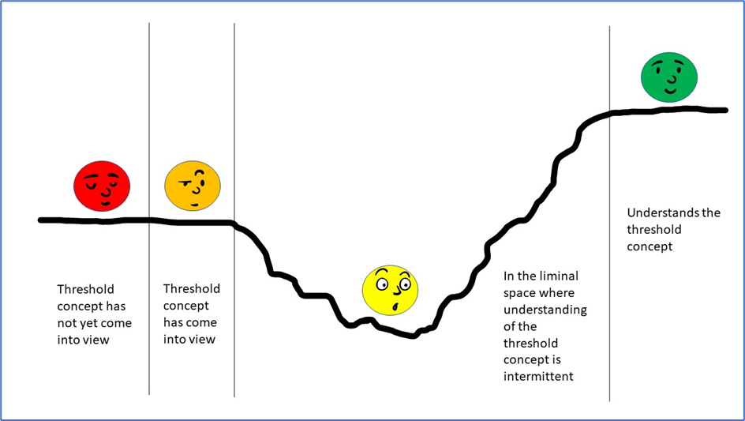
Liminality
Session 1 From resistance to reframing – how we understand and respond to change

Slide 8
Learning Outcomes
Session 1 From resistance to reframing – how we understand and respond to change
Key theories in response to change from a human centred perspective.
Develop reflective insight into your personal response to complexity, a key leadership attribute in MBA-level development. ​
Explore the mindset shift from passive reaction to active adaptation, mirroring the reflective and analytical capacities nurtured on the #nclMBA.

Slide 9
Conclusions
Session 1 From resistance to reframing – how we understand and respond to change
Revisit learning outcomes for this session​
Review personal learning objectives – complete (marks out of 5)​
Homework: ​
Write a reflective journal using these three questions as prompts:​
  When I think about a recent change in my work life, how did I respond both emotionally and practically? What does that tell me about how I tend to navigate change?​
  In times of uncertainty or transition at work, do I tend to feel like the pilot or a passenger on the plane, and what helps me reclaim a sense of control or direction?​
  What does the ‘neutral zone’ or liminal space feel like for me? How can I make peace with that in-between space and become more accustomed to feeling uncomfortable?​
Next time: Organisational Responses to Change…​

