Slide 1
Session 2
Resilience isn’t bouncing back – it’s reinventing forward

Slide 2
Learning Outcomes
Session 2 Resilience Isn’t Bouncing Back – It’s Reinventing Forward
Design for organisational adaptability, change as the status quo​
Engage with entrepreneurial and innovation thinking as tools for navigating uncertainty, core elements of the #nclMBA curriculum. ​
Identify and strengthen your own resilience strategies, preparing you for high-responsibility roles and the demands of postgraduate management education.

Slide 3
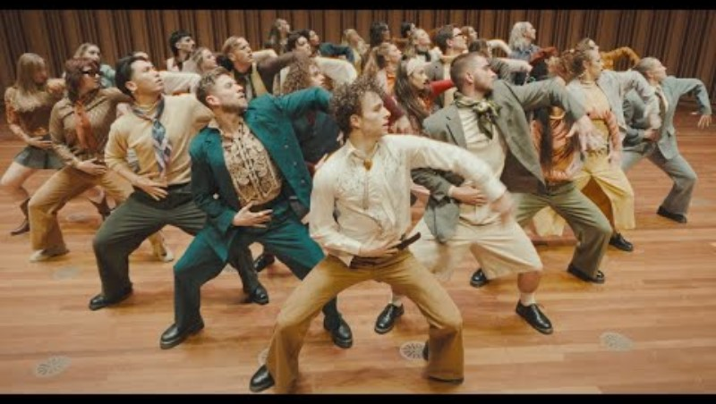
Icebreaker
Session 2 Resilience Isn’t Bouncing Back – It’s Reinventing Forward
Post your “songs for change” in the chat​
  “Let It Be” – The Beatles​
  “The Times They Are A-Changin’” –Bob Dylan​
  “Fight Song” – Rachel Platten​
  “Stronger” – Kelly Clarkson​
  “Dog Days Are Over” – Florence + The Machine​
  “Somebody I Used to Know” – Gotye

Slide 4
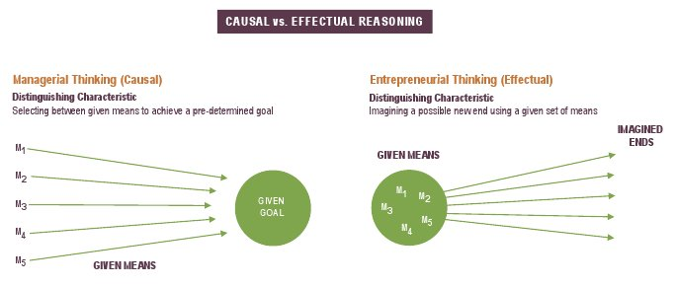
Effectual Reasoning
Turning traditional management thinking on its head
Session 2 Resilience Isn’t Bouncing Back – It’s Reinventing Forward
Traditional Management Thinking​
  Goals ​
  Expected return​
  Competition​
  Avoid surprises​
  Plan – to the extent we can predict the future, we can control it​
Effectual Thinking​
  Means​
  Affordable loss​
  Partnership​
  Leverage surprises​
  Co-create – to the extent we can control the future, we don’t need to predict it
effectuation.org

Slide 5
Innovate or Die
Session 2 Resilience Isn’t Bouncing Back – It’s Reinventing Forward
WTTMSW—Whoever Tries The Most Stuff Wins​
Competitive advantage arises not from master plans but from an organization's capacity to experiment, fail, and adapt faster than the competition. ​
tompeters.com
​Innovation as a way of life​
  Bias for Action
  Fail Forward, Fast
  Prototyping as Core Competency
  Serious Play

Slide 6
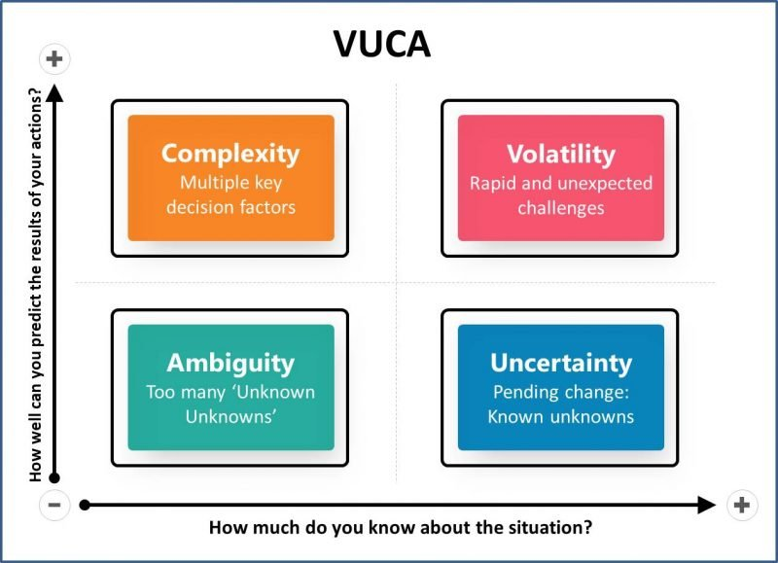
Understanding threats to performance in a VUCA world
Session 2 Resilience Isn’t Bouncing Back – It’s Reinventing Forward
VUCA (Volatile, Uncertain, Complex, Ambiguous) each word presents distinct challenges to decision-making and performance.​
Situations are rarely volatile, uncertain, complex and ambiguous to the same extent: Leaders must diagnose the specific VUCA condition to respond effectively.​
Bennett, N. and Lemoine, G.J., 2014. What a difference a word makes: Understanding threats to performance in a VUCA world. Business horizons, 57(3), pp.311-317.

Slide 7
Understanding threats to performance in a VUCA world Continued
Session 2 Resilience Isn’t Bouncing Back – It’s Reinventing Forward
Language shapes action: How an organisation labels its challenges (e.g., “uncertain” vs. “complex”) will influence the strategies it chooses.​
Tailored responses are key:​
      Volatility → Build slack & agility​
      Uncertainty → Invest in information & scenario planning​
      Complexity → Restructure, clarify roles, reduce noise​
      Ambiguity → Experiment, test, and learn​
Framing matters: Reframing challenges accurately can boost confidence and improve performance outcomes

Slide 8
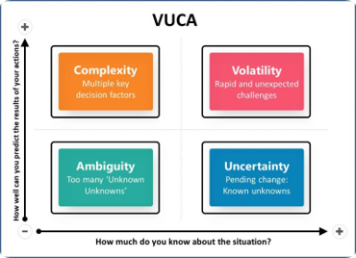
Small Group Exercise
Session 2 Resilience Isn’t Bouncing Back – It’s Reinventing Forward
What element of VUCA is most pertinent to your organisation now and why? (if you are notworking currently, think of your most recent employer, university or school?)​
Be ready to share what you noticed about emerging patterns or themes in your discussions

Slide 9
Learning Outcomes
Session 2 Resilience Isn’t Bouncing Back – It’s Reinventing Forward
Design for organisational adaptability, change as the status quo​
Engage with entrepreneurial and innovation thinking as tools for navigating uncertainty, core elements of the #nclMBA curriculum. ​
Identify and strengthen your own resilience strategies, preparing you for high-responsibility roles and the demands of postgraduate management education.

Slide 10
Conclusions
Session 2 Resilience Isn’t Bouncing Back – It’s Reinventing Forward
Revisit learning outcomes for this session​
Review personal learning objectives – complete (marks out of 5)​
Homework: ​
Write a reflective journal using these three questions as prompts:​
  Reflecting on the approaches we’ve be discussing in today’s session, how well does my organisation (or one I know well) typically navigate change?​​
  Where could I apply effectual reasoning to enable both my organisation and myself to navigate change more effectively?​​
  How relevant are the ideas we’ve discussed today in today’s world?​
Next time: Designing your Career in a non-linear world…​

