Slide 1
Session 3
Designing your career in a non-linear world

Slide 2
Learning Outcomes
Session 3 Designing your career in a non-linear world
Connecting value and values in the context of value creation for yourself and for others: key themes in the #nclMBA. ​
Connect entrepreneurial thinking to real-world career planning, showcasing the kind of strategic mindset valued in MBA applicants. ​
Create an action plan that reflects not only your current goals but the potential for future leadership development through further study such as the #nclMBA

Slide 3

Icebreaker
Session 3 Designing your career in a non-linear world
Post in the chat: your childhood career aspirations

Slide 4

Individual Task
Session 3 Designing your career in a non-linear world
Develop your own personal learning outcomes for this short course on “Navigating Change”​
Edit them on the Padlet Board​

Slide 5
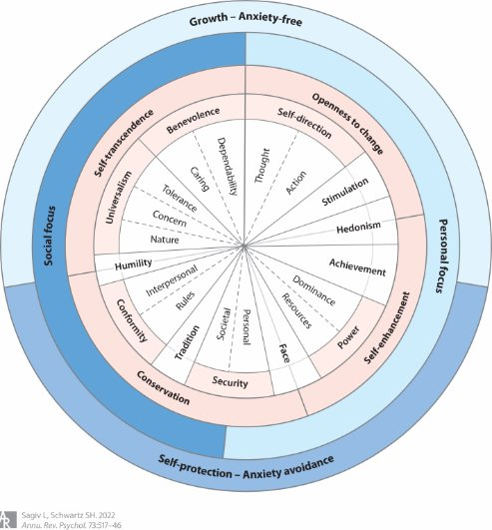
Values
Session 3 Designing your career in a non-linear world
The circular continuum of 10 values in the original Schwartz theory, with the four higher-order values and two underlying organizing principles.
Figure adapted from Schwartz & Cieciuch (2021). In Sagiv, L. and Schwartz, S.H., 2022. Personal values across cultures. Annual review of psychology, 73(1), pp.517-546.​
Available from: www.annualreviews.org/content/journals/10.1146/annurev-psych-020821-125100#right-ref-B135

Slide 6

Session 3 Designing your career in a non-linear world

Slide 7
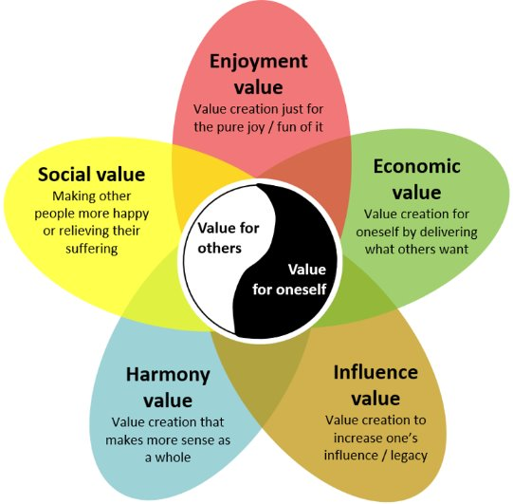
Values, value and value creation
Session 3 Designing your career in a non-linear world
Figure 2.1 Model with five different perspectives on value that can be created for oneself or for others. From Lackéus (2018).
Chapter 2: Value creation in education | VCPLIST.COM

Slide 8
Learning for an unknown future
Session 3 Designing your career in a non-linear world
Knowledge and skills are not enough in today’s uncertain, complex world​
We live in an age of super-complexity where multiple, conflicting worldviews make the world not only unknowable, but often indescribable​
Traditional approaches aim for certainty; but future-ready learning requires on to logical development where we focus on being, not just knowing or doing.

Slide 9
Learning for an unknown future Continued
Session 3 Designing your career in a non-linear world
ACTION: Cultivate the whole person​
To be effective we must develop dispositions like:​
    Resilience, humility, criticality, courage, stillness​
Leaders and Managers should embrace high-risk, transformative organisational cultures that:​
    Foster self-confidence and self-direction​
    Accepts ambiguity and nurtures inner stability​
    Are free from fear​
Learning for an unknown future means learning to live with uncertainty and being able to act wisely when certainty is impossible.

Slide 10
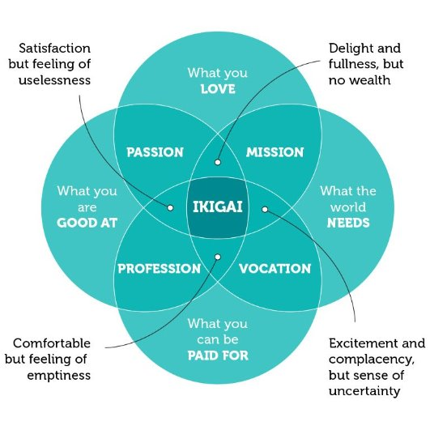
Session 3 Designing your career in a non-linear world

Slide 11
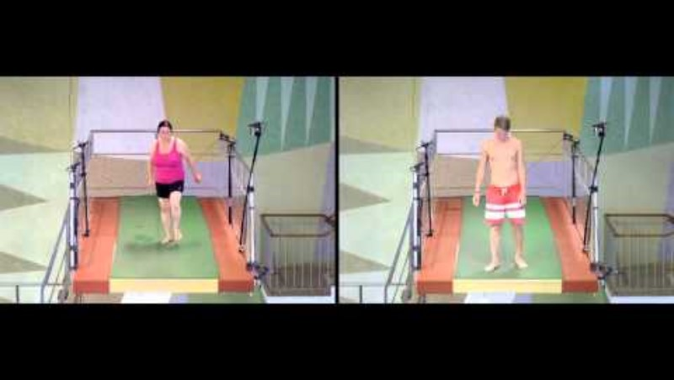
Session 3 Designing your career in a non-linear world

Slide 12
Learning Outcomes
Session 3 Designing your career in a non-linear world
Connecting value and values in the context of value creation for yourself and for others: key themes in the #nclMBA. ​
Connect entrepreneurial thinking to real-world career planning, showcasing the kind of strategic mindset valued in MBA applicants. ​
Create an action plan that reflects not only your current goals but the potential for future leadership development through further study such as the #nclMBA
“It is not the strongest of the species that survives, nor the most intelligent that survives. It is the one that is most adaptable to change”.
Chares Darwin

Slide 13
Conclusions
Session 3 Designing your career in a non-linear world
Revisit learning outcomes for this session​
Review personal learning objectives – complete (marks out of 5)​
Homework: Create a personal action plan that reflects not only your current goals but the potential for future leadership development through further study such as the #nclMBA.​
For a digital badge: On the Canvas Discussion Board: Post 250 words on one key idea for navigating change that you plan to take away from these sessions to apply in your life. Describe the idea in your own words, set out why you chose it, how you plan to apply it and what value you are hoping to create as a result for yourself and others.

