Slide 1
Children’s jobs in the Mines

Slide 2

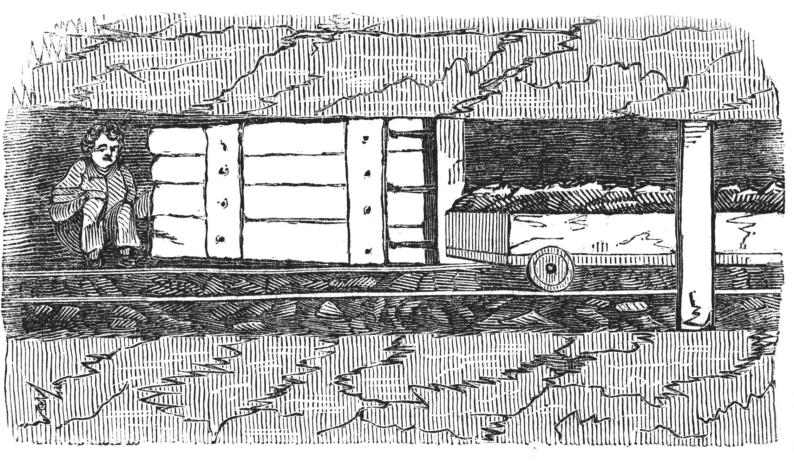
Age: 5+
Conditions:
12-14 hour shift. As the cost of candles had to come out of their pay they were too expensive. This meant they had to sit in the dark throughout their shift. They were not allowed to sleep.
Description:
Had to sit by wooden doors in the mine, called trap doors, and to open them when a tub or cart of coal was ready to pass through. This opening and shutting of the door was also an important safety feature of the mine as it controlled the air flow.

Slide 3
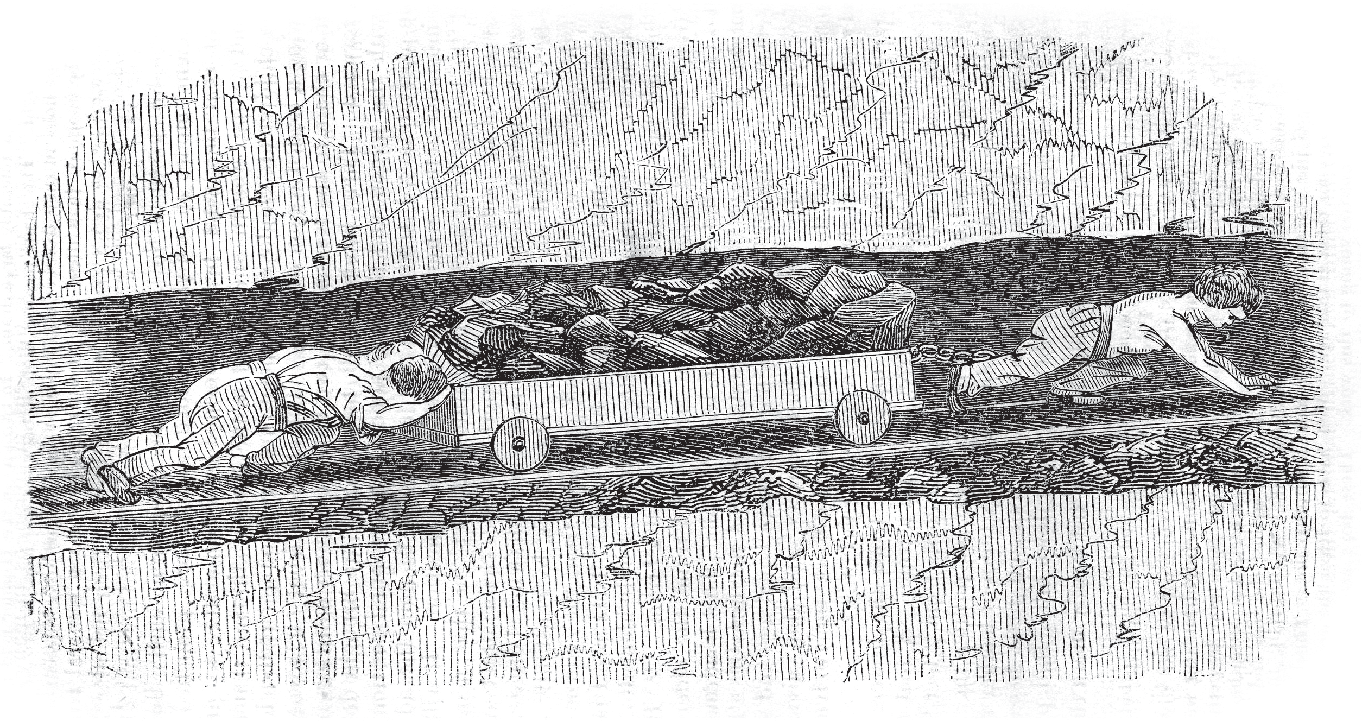
Age: older children (8 upwards)
Conditions:
12-14 hour shift, hard manual labour in cramped conditions. Due to nature of continued harsh conditions children could grow with deformities or loss of hair due to pushing the heavy carts.
Description:
The role of the job was to transport the coal from the coalface to the shaft where it could be lifted up to the surface.
Hurriers wore a harness and had to pull the carts of coal.
Thrusters helped push the tub of coal, often using their head.

Slide 4

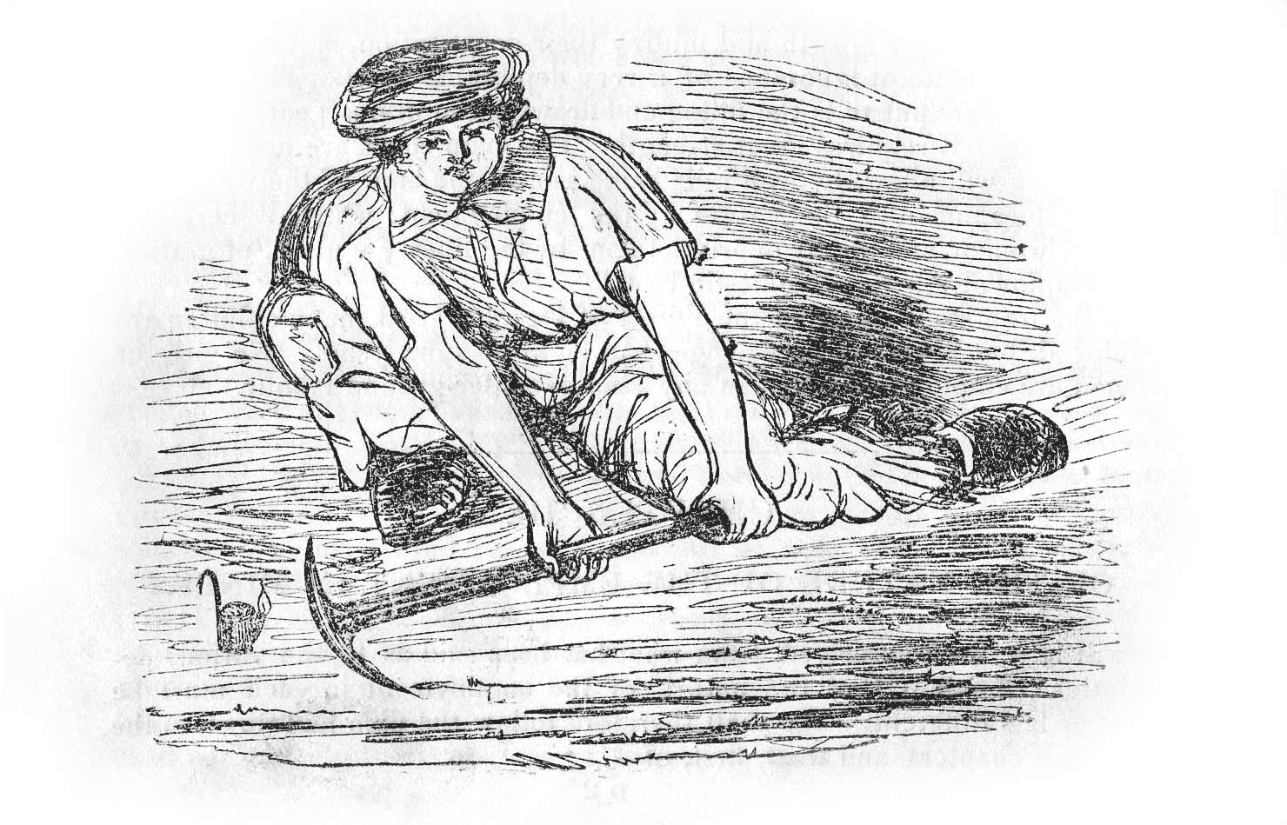
Age: 14+
Conditions:
12-14 hour shift, provided with candle or lamp so they could see the coal.
Worked at the coalface.
Description:
Use a pick-axe to mine coal out of the coalface. Some seams of coal could be very narrow and tight to manoeuvre in.

Slide 5

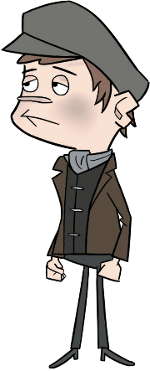
Age: 8+
Conditions:
12-14 hour shift, above ground, dusty, dangerous work.
Description:
To sort coal from rock and slate by eyesight and hand. Then sort coal into size.
Backbreaking work using dangerous machinery with no safety guards.

Slide 6
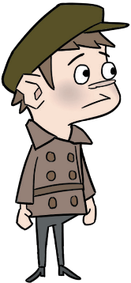
Arguments for children working in the mines
Money
For mining family.
For mine owner who doesn’t need to pay high wage.
Size
Size of young children means they can do jobs adults are unable to.

Slide 7
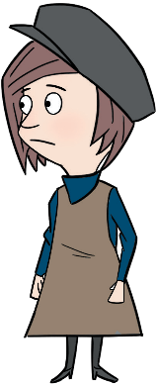
Arguments against children working in the mines
Children as young as five expected to work
Working conditions
Lack of light Long hours
Monotonous work.
Low pay
Lack of schooling
Health
Lungs.
Deformities as grow up in cramped conditions.
Average life expectancy 25 years.

Slide 8


Newcastle University Library
Explore the Possibilities
ncl.ac.uk/library

