Slide 1
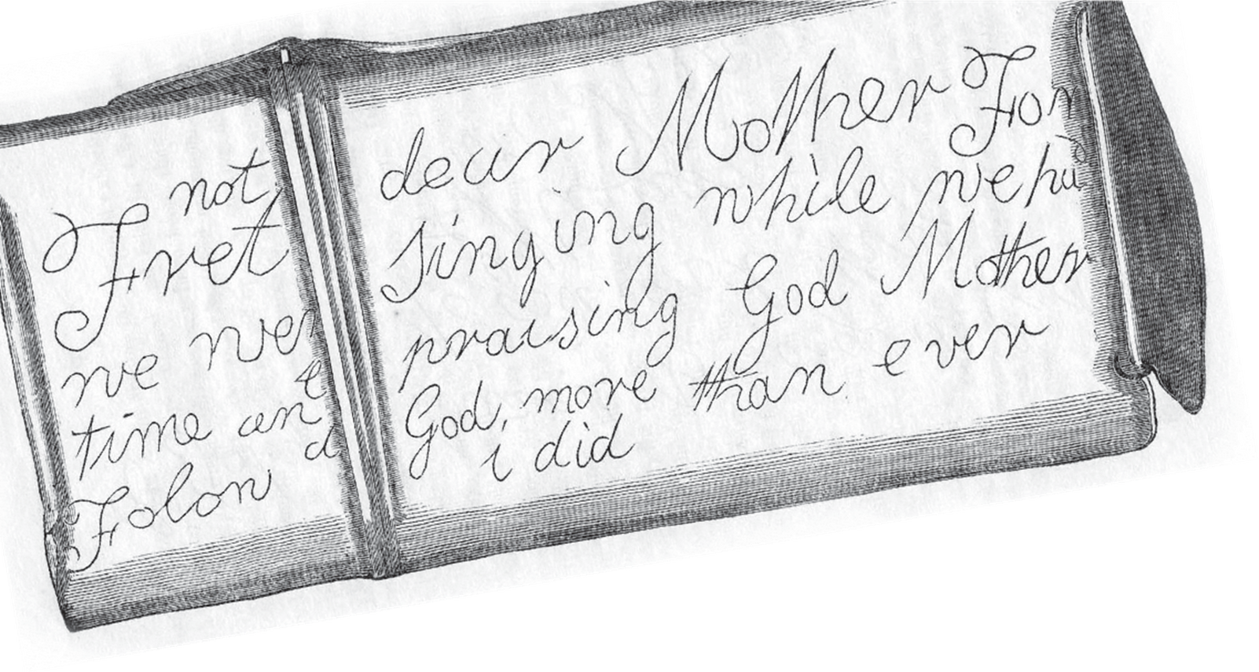

Heaton
Pit Disaster
3 May 1815

Slide 2
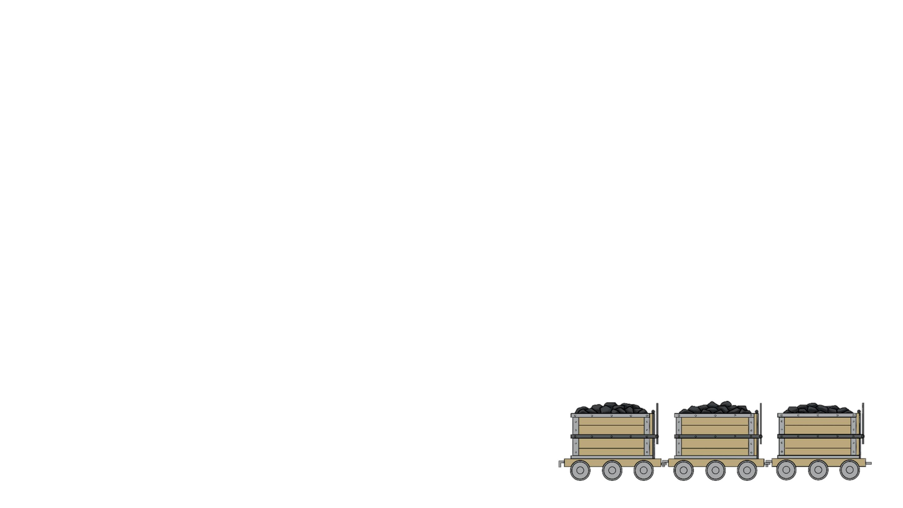
What happened?
• On May 3rd 1815, there was a flood in Heaton Main Colliery.
• Shafts that were no longer used (known as Heaton Banks) had filled with water.
• At 4:30am water came through into the main shaft.
• Those working closest ran to the shaft and managed to escape.
• The majority were working further away and were quickly trapped by the water with no way
out.

Slide 3

What happened?
• Three large engines were brought in to pump the water out.
• By the following night it was clear they had failed, and the water continued to rise.
• 75 people died, including 41 men and 34 boys.
• All of the horses working in the mine died.
• It took nine months to reach and recover the bodies,

Slide 4

How did they die?
• The flooding of the bottom of the shaft meant the
miners could not get out.
• Horse meat was found near the miners suggesting
they did not die of starvation.
• The miners' belongings that contained metal had
eroded (for example, their watches, or knives),
suggesting they died by inhaling noxious gases
within two days of the disaster.

Slide 5

William Thew
William Thew was the second eldest son of
John and Elizabeth Thew. He was down the
mine with his father, elder brother and
younger brother. His youngest brother was
working higher up the shaft and escaped.
William, his father and elder brother were all
trapped in the mine. Before he died, he
etched a last message to his mother on his
candle tin using the light of his Davy lamp.

Slide 6
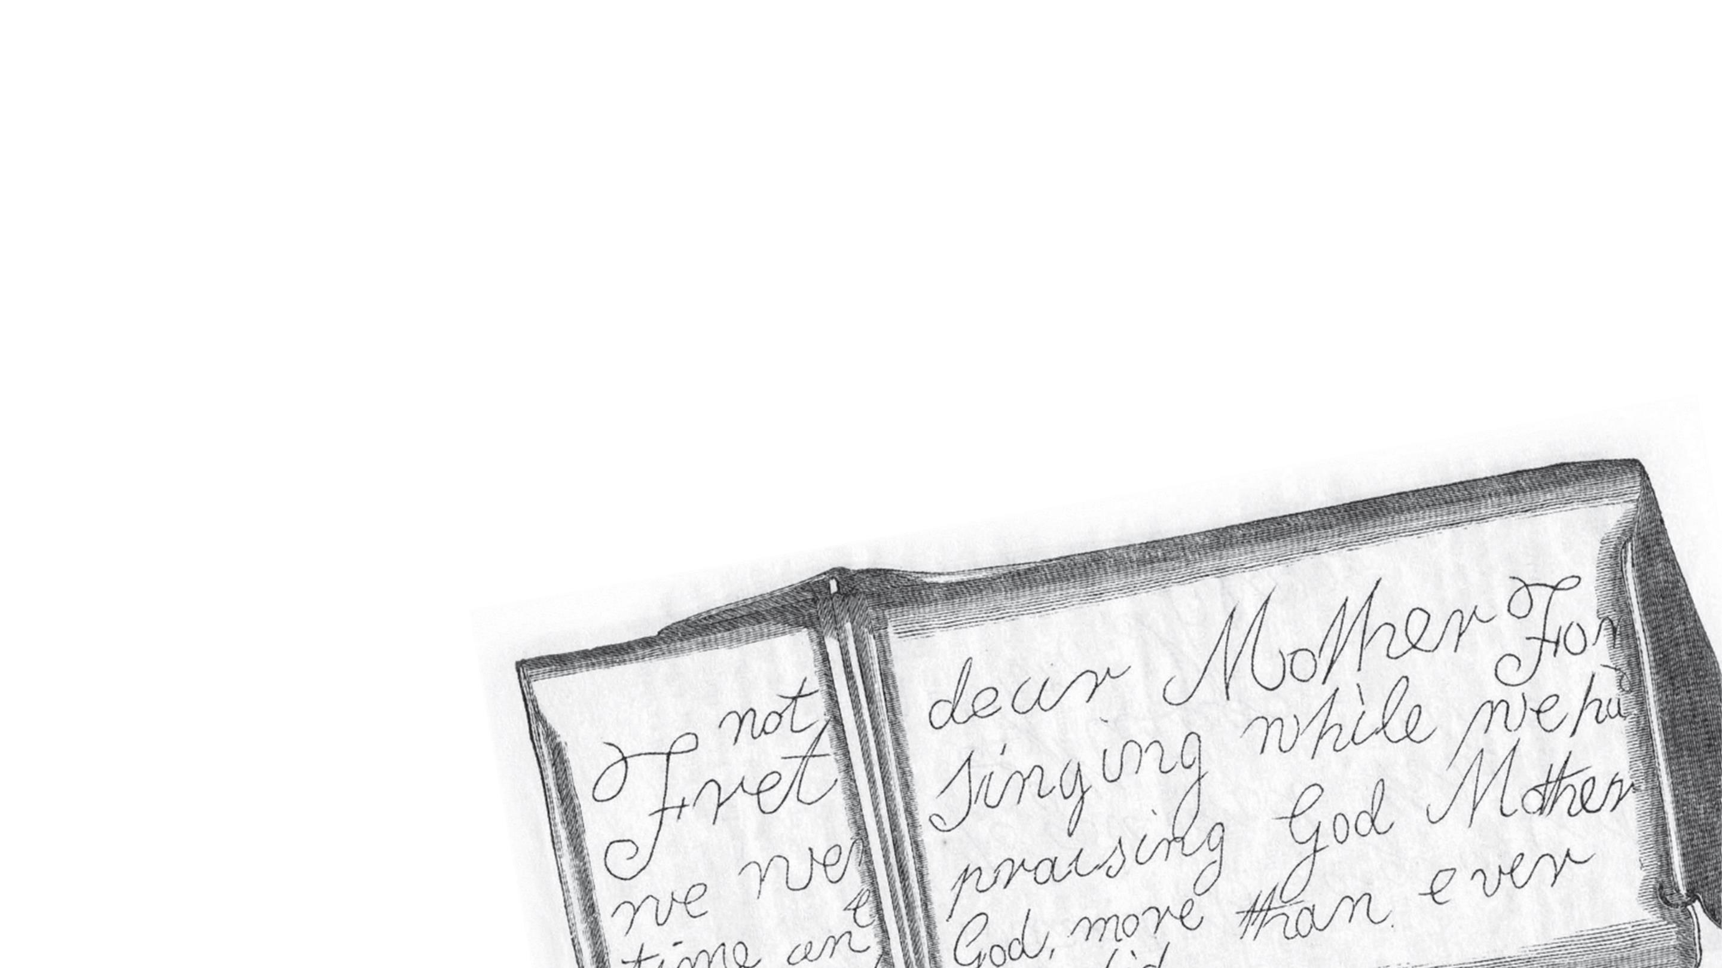
William Thew
“Fret not, dear mother, for we were singing while we had time, and praising God.
Mother, follow God more than I ever did”

Slide 7
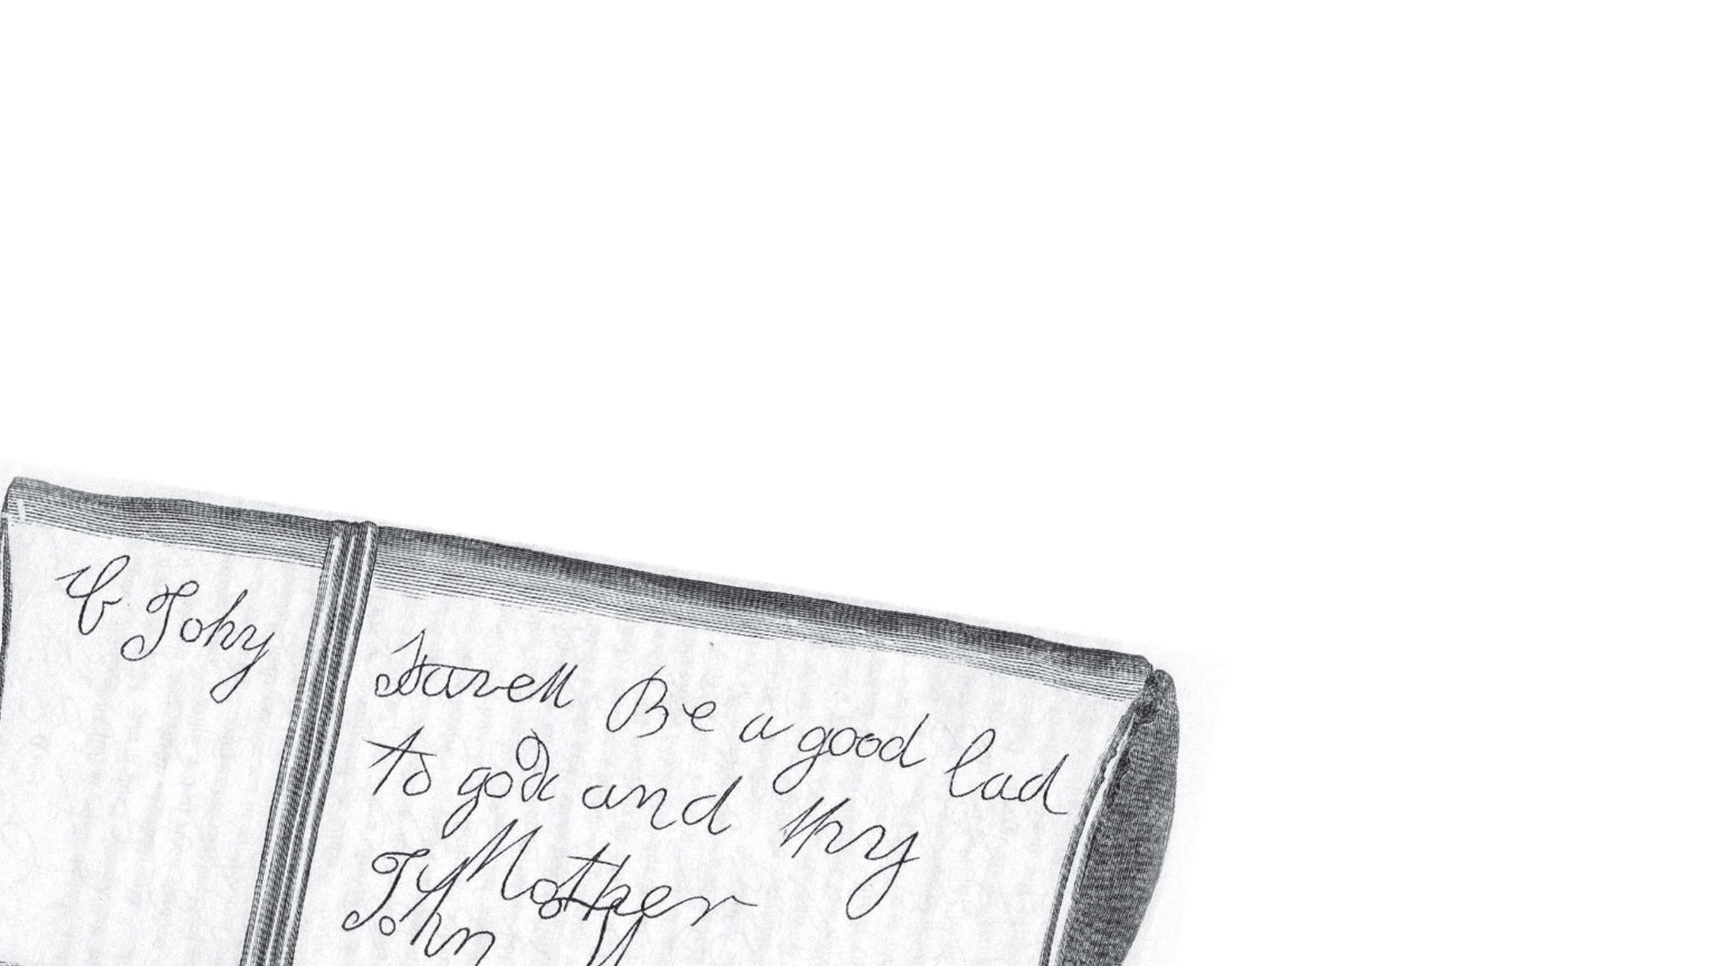
William Thew
On the other side, presumably dictated by his father as he could not
read and write:
“If Johnny is saved, be a good lad to God, and thy mother. JOHN THEW”

Slide 8
Newcastle University Library
Explore the Possibilities
ncl.ac.uk/library

