Slide 1
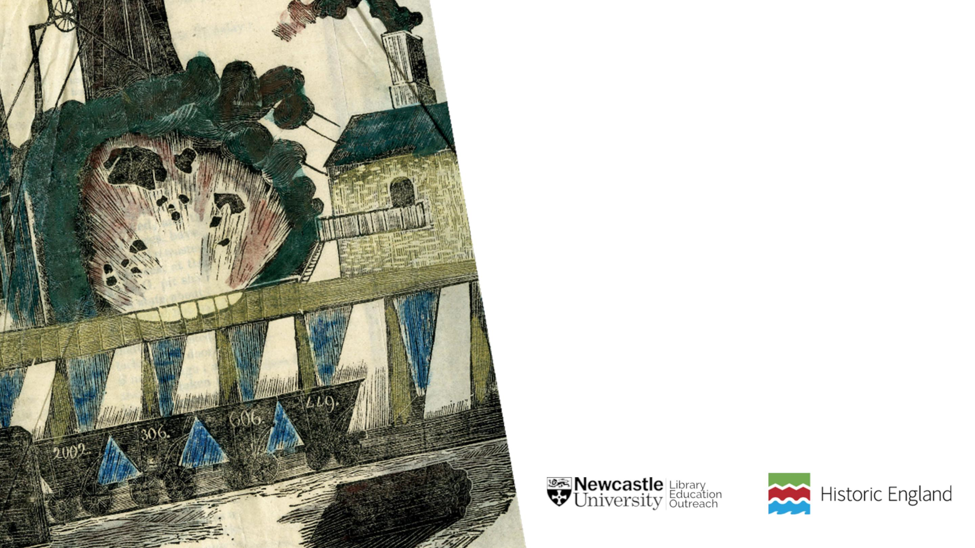
Wallsend Pit
Disaster
23 October 1821

Slide 2

What happened?
• At around 8am, New Belcher Seam
in Wallsend Colliery exploded.
• It is believed to have been caused
by hydrogen gas catching alight.
Newspaper report on the Dreadful Explosion at the Pit at Wallsend Colliery. Rare-RB Folio 622 08 Wil-Pitman’s Papers-Volume I-Page 21

Slide 3

Losses
• Only two out of the 56 men working in the
mines escaped without injury.
• 50 men died in the immediate accident, two
died shortly afterwards and two were severely
burnt.
• The bodies were found in a bad state, and two
were not found until the next day.
• Many of the victims left behind large families
with seven or eight children.
• One of victims was also a schoolmaster, and
left behind a widow and large family behind.

Slide 4

Mourning
• 46 of the victims were buried at
Wallsend in one grave as they were all
related, and the rest were buried at
Ballast Hills and old Wallsend Church.
• Coffins were provided by the owners of
the Colliery, as well as money towards
the cost of the funerals for each victim.
• The rest of the collieries in the
neighbourhood were closed to allow
workmen to attend the funerals.
• Several thousand people showed up.

Slide 5

Newcastle University Library
Explore the Possibilities
ncl.ac.uk/library

