Slide 1
Safety in the mines
What were the main dangers faced by people working in the mines in the 19th century?

Slide 2
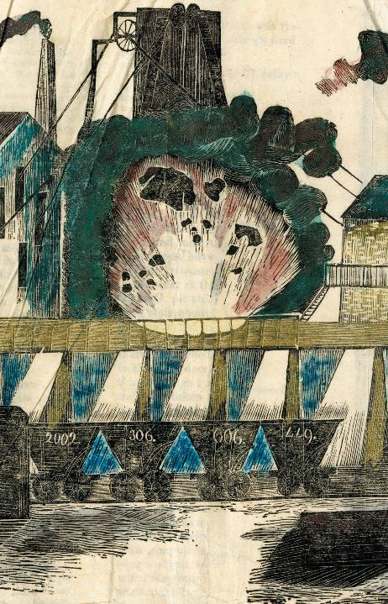
Dangers faced by miners in the 19th century
In the 19th century mines were dangerous places to work. Some of the main dangers miners faced were:
Flooding Getting trapped Poor ventilation
Explosions Being crushed Falling

Slide 3
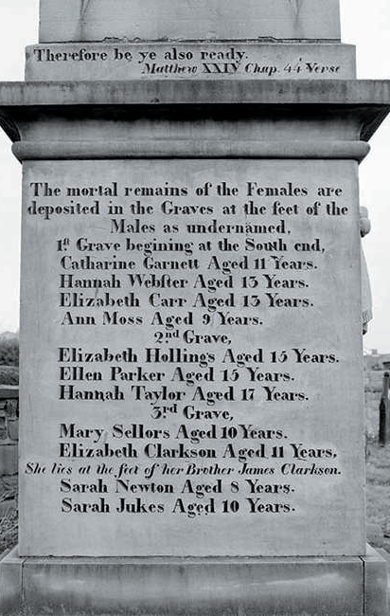
Danger 1: Flooding
Flooding was a common problem facing people working in the mines.
In 1838, there was terrible disaster at Huskar pit, near Barnsley, Yorkshire.
The mine flooded, resulting in the death of 26 children.

Slide 4
Danger 2: Getting trapped
In the 1900s, it was not uncommon for miners to lose their lives as a result of becoming trapped below ground.
In January 1862, 204 men and boys got trapped and died at Hester pit, at New Hartley Colliery in Northumberland, when the beam of the pit’s pumping engine (which was used to pump water out of the pit) broke, and half of it fell down the mine-shaft.

Slide 5
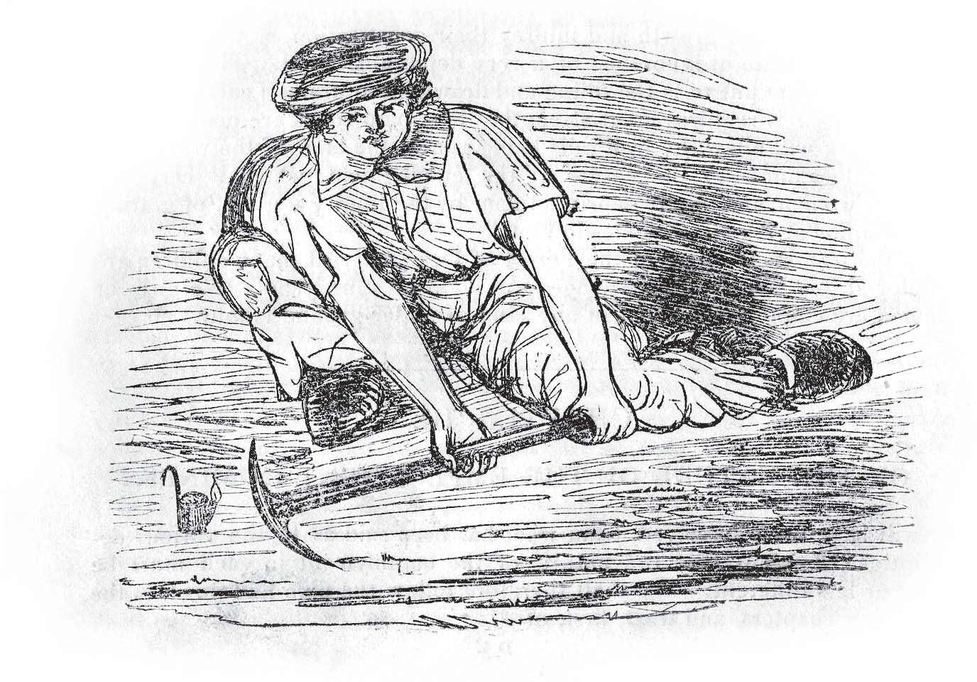
Danger 3: Poor ventilation
Poor ventilation was big problem in the mines in the 1900s.
The air underground contained high levels of coal-dust.
Many miners suffered from lung problems including emphysema, bronchitis and ‘black lung disease’.
It was not uncommon for miners to die at an early age because of these health problems.

Slide 6
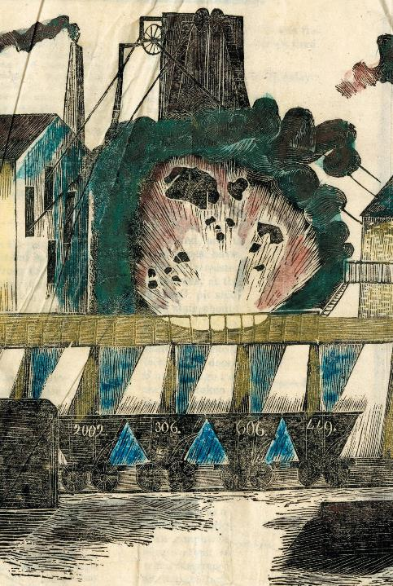
Danger 4: Explosions
Dangerous gases known as fire-damp built up in the mines.
These gases could be ignited by candles, causing big explosions.
Explosions were a common cause of mining accidents in the 19th century.
One such accident happened at Wallsend on 23rd October,1821.
The Wallsend explosion resulted in the death of 52 of the 56 men working in the pit.

Slide 7
Danger 5: Being crushed
Many mining accidents in 19th century were the result of the roof collapsing.
Children working in the mines could also be crushed by the carts or rollies which were used to transport the coal along rails to the mine shaft where it would be raised to the surface.

Slide 8
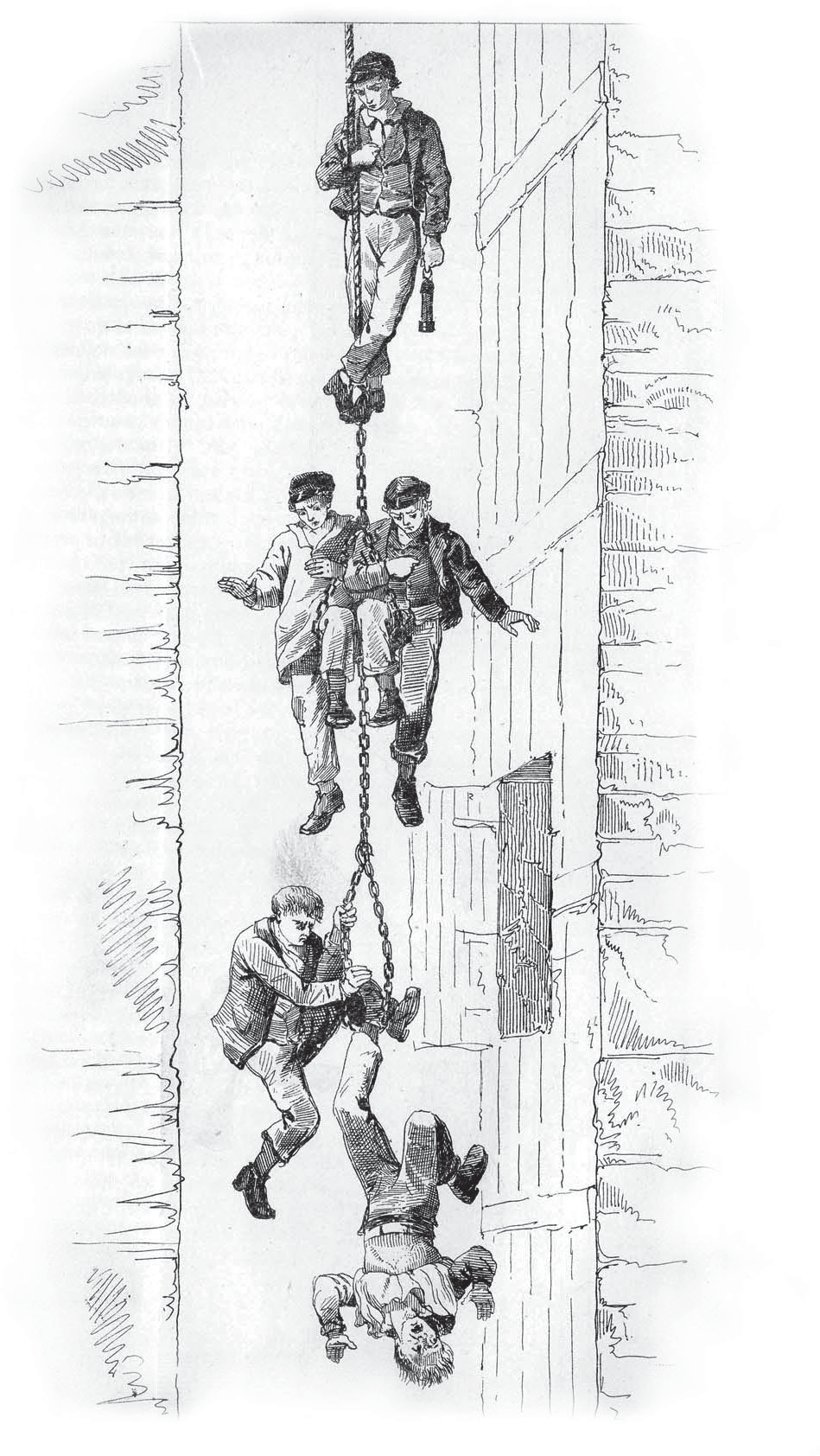
Danger 6: Falling
Many accidents in the mines happened as the miners were being lowered down or raised up the mine shaft.
It was not uncommon for people to fall down the mine shaft on their way down to the coal face.
Some deaths were caused by miners falling as they were being raised back up the mine shaft at the end of their shift.

Slide 9
Newcastle University Library
Explore the Possibilities
ncl.ac.uk/library

