Slide 1
Improvements to Safety in the Mines
Why were there calls to improve safety in the mines in the 19th century?
How did new inventions improve safety in the mines?
How did new laws improve safety in the mines?

Slide 2
Why were there calls to improve safety in the mines?
Accidents in the mines were common in the 19th century.
Many people working in the mines were injured or killed as a result of shaft accidents, explosions, roof falls and drowning.
News about disasters such as the Huskar pit disaster of 1832 where 26 children lost their lives shocked people.
Queen Victoria took an interest in this disaster and shortly afterwards a Royal Commission was set up to enquire into women and children working in the coal mines.

Slide 3
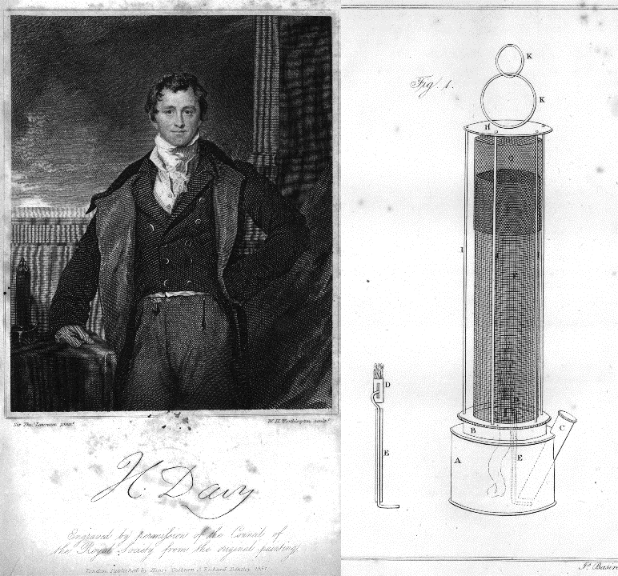
How did new inventions improve safety in the mines?
New inventions including steam pumps and the miner’s safety lamp improved safety in the mines.

Slide 4
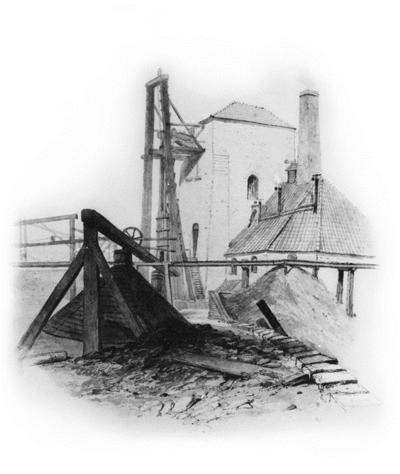
Invention 1: Steam pumps
Steam powered pumps were used to remove water from the mines.
In 1698, Thomas Savery began promoting his steam pump (which he referred to as ‘the miner’s friend’).
From 1712 Thomas Newcomen’s steam pump was used to pump water out of mines.
Newcomen’s steam pump was improved by James Watt who, in 1776, designed a machine which was much more powerful.
However, although steam pumps helped deal with flooding, they couldn’t prevent flooding altogether.
Indeed, in the Heaton Colliery disaster of 1815, three large engines were used to draw water from the pit, but they couldn’t cope with the amount of water pouring in.

Slide 5
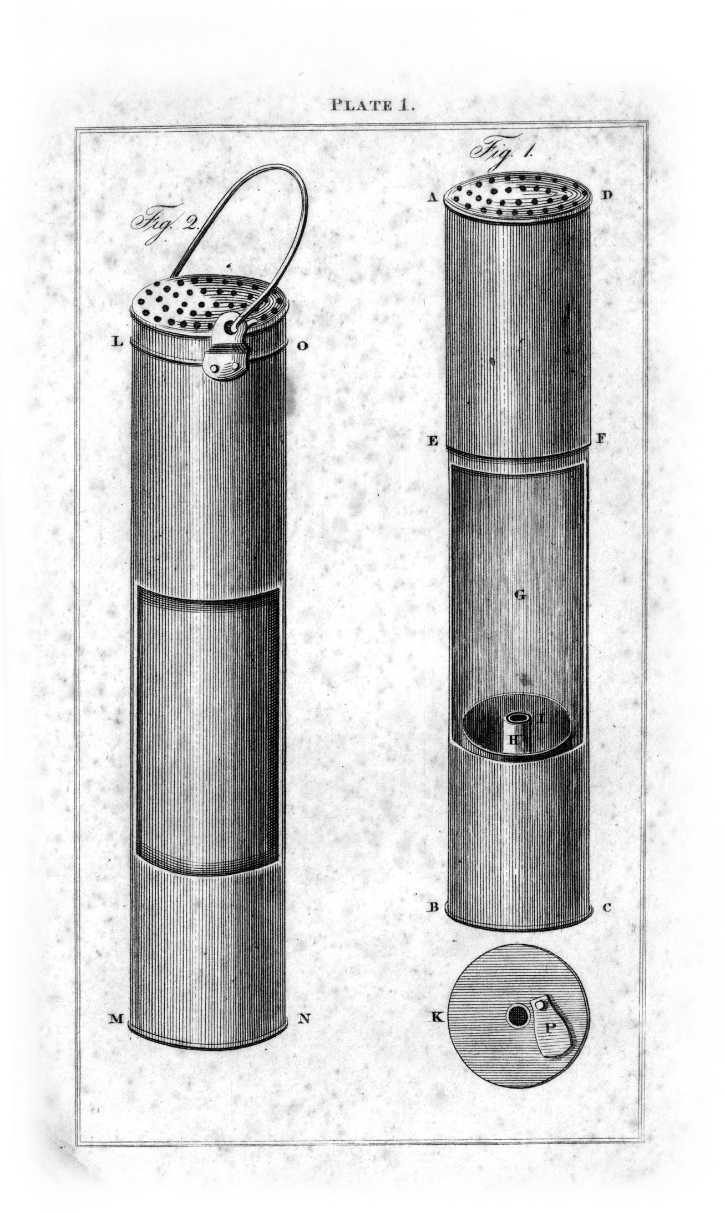
Invention 2: Safety Lamps
In 1815 Sir Humphry Davy invented a miner’s safety lamp with metal gauze around the flame.
The Davy lamp enabled light to pass through the holes in the gauze but prevented the flame igniting the gas in the mines.
In the same year, George Stephenson also invited a safety lamp known as the Geordie Lamp.

Slide 6
How did new laws improve safety in the mines?
From the mid-1800s onwards a series of new laws helped to improve safety in the mines.

Slide 7
New Laws - 1
1842 Mines Act
No child under 10 to work.
No women to work underground.
1862 Prohibition of Single Shaft Mines Act
As a result of the Hartley Colliery disaster which killed 204 men, all mines had to have at least 2 shafts so that if one was cut off, there was another way to escape.

Slide 8
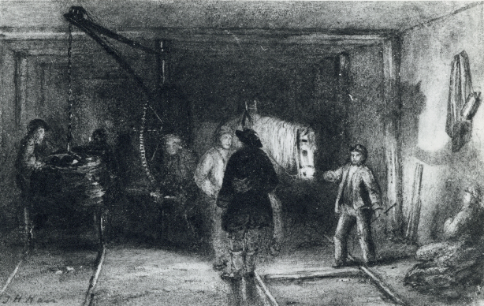
New Laws - 2
1872 Regulation of the Coal Mines Act
Pit managers had to have professional qualifications.
1911 The Coal Mines Act
Limited work to 8 hours per day.
Banned boys under 14 from working below ground.
Banned boys under 16 from working at night.
Required mine owners to take care of the welfare of pit ponies required mine owners to have rescue stations with rescue equipment and trained rescue teams.

Slide 9
Newcastle University Library
Explore the Possibilities
ncl.ac.uk/library

